Slide 1
Education
General Topics for The New Maturita Exam
Mgr. Veronika Richterová
VY_32_INOVACE_43-05_VP_Education

Slide 2

Types of Schools
Divide the correct names into the chart
 | American English | British English
Mateřská škola
Základní škola
Střední škola
Vysoká škola
Soukromá škola
Primary school
Private school
University
Secondary school
Middle school/Junior high school
Kindergarten
Nursery school
Public school

Slide 3
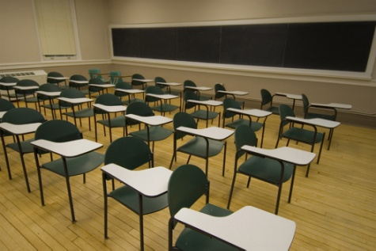
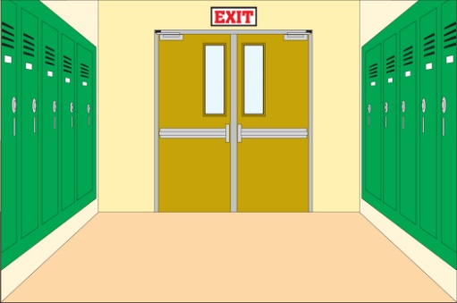

Places in a School
COMPUTER ROOM
CANTEEN
CORRIDOR
CLASSROOM
LIBRARY

Slide 4
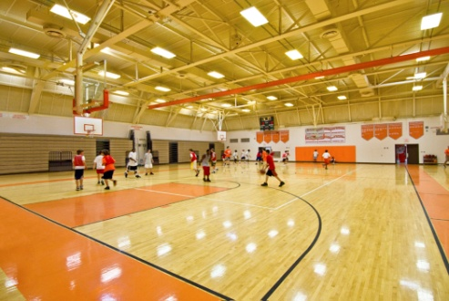


HEADMASTER‘S OFFICE
OFFICE
PLAYGROUND
GYM
LABORATORY

Slide 5


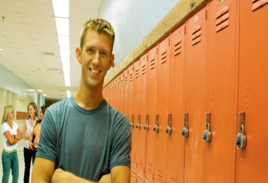

People in a School
ŽÁK
UČITEL
PUPIL
TEACHER
STUDENT
TŘÍDNÍ UČITEL
FORM TEACHER
STUDENT
PROFESOR
VYSOKOŠKOLÁK
COLLEGE
STUDENT
PROFESSOR
SPOLUŽÁK
CLASSMATE/
SCHOOLMATE
ZÁSTUPCE ŘEDITELE
DEPUTY HEAD
ŘEDITEL
ŠKOLÁK/
ŠKOLAČKA
HEAD TEACHER
HEADMASTER
SCHOOLBOY
SCHOOLGIRL

Slide 6
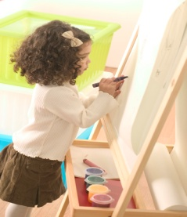
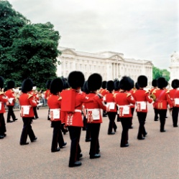
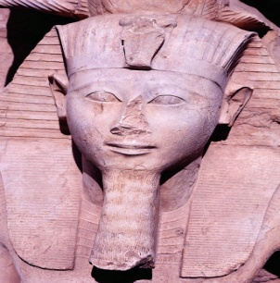
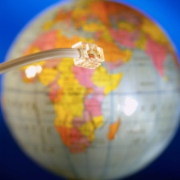
School Subjects
ART
YOU DRAW AND PAINT HERE
ENGLISH LANGUAGE AND LITERATURE
YOU SPEAK ENGLISH HERE
HISTORY
GEOGRAPHY
YOU LEARN ABOUT THE PAST
YOU LEARN ABOUT COUNTRIES AND NATURE
INFORMATION AND COMMUNICATION TECHNOLOGY
YOU LEARN HOW TO WORK WITH PC
(PE)
PHYSICAL EDUCATION
YOU DO EXERCISE HERE

Slide 7
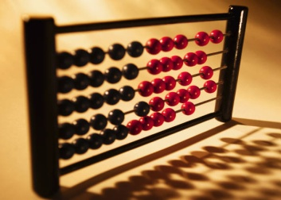

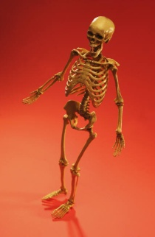
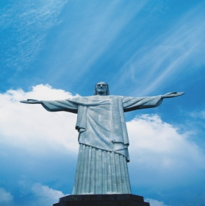
MUSIC
YOU SING AND PLAY MUSICAL INSTRUMENTS
MATHEMATICS
MATHS
YOU COUNT AND DO CALCULATIONS HERE
BIOLOGY
YOU LEARN ABOUT HUMAN BODY AND ANIMALS HERE
RELIGIOUS EDUCATION
YOU PRAY AND LEARN ABOUT GOD
PHYSICS
CHEMISTRY
YOU LEARN ABOUT THE PHYSCIAL LAWS
YOU LEARN ABOUT CHEMICAL ELEMENTS

Slide 8
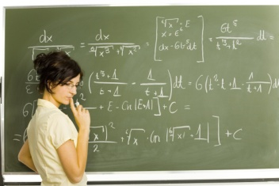
School Objects
BLACKBOARD
FILE
RULER
CHALK
RUBBER

Slide 9


EXERCISE BOOK
NOTEBOOK
TEXTBOOK
PENCIL CASE
PEN
FOLDER

Slide 10
Guess the Vocabulary
To go to a school - __ __ __ __ __ __ school
A student who finished studies __ __ __ __ __ __ __ __
A term until which you must submit work: __ __ __ __ __ __ __ __
The teacher evaluates your work with: __ __ __ __
Some students just memorise –learn by __ __ __ __ __
Clever and poor students can get _ __ __ __ __ __ __ __ __ __ _
A
T
T
E
N
D
G
R
A
D
U
A
T
E
D
E
A
D
L
I
N
E
M
A
R
K
H
E
A
R
T
S
C
H
O
L
A
R
S
H
I
P

Slide 11
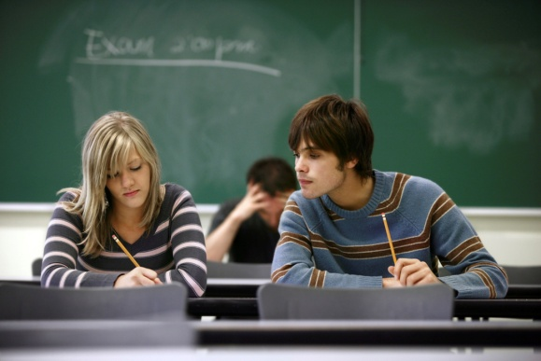
Exams
ZKOUŠKA
VÝSLEDEK
EXAM
RESULT
PODVÁDĚT
ZNOVU VYKONAT
RETAKE AN EXAM
CHEAT
OPAKOVAT NA ZKOUŠKU
SKLÁDAT ZKOUŠKU
DO/TAKE/
SIT AN EXAM
REVISE FOR AN EXAM
ZÁVĚREČNÁ ZKOUŠKA
ZÍSKAT BODY
SCHOOL-LEAVING EXAM
SCORE MARKS
UDĚLAT ZKOUŠKU
PASS AN EXAM
NEUDĚLAT, NEUSPĚT
FAIL AN EXAM

Slide 12
Qualities
__ __ __ __ __ __ __ __ __
CTIŽÁDOSTIVÝ
A
M
B
I
T
I
O
U
S
SPOLUPRACUJÍCÍ
C
O
O
P
E
R
A
T
I
V
E
NÁROČNÝ
D
E
M
A
N
D
I
N
G
SPRAVEDLIVÝ
F
A
I
R
TALENTOVANÝ
G
I
F
T
E
D
NÁPADITÝ
I
M
A
G
I
N
A
T
I
V
E
PŘÍSNÝ
S
T
R
I
C
T
DOCHVILNÝ
P
U
N
C
T
U
A
L

Slide 13
Guess the Characteristics
Jane is not a good student. She is not stupid, but she is very __ __ __ __ - she never works!
I like our new teacher – she makes us work hard because she is very __ __ __ __ __ __ __ __ __ __!
I hate Mr. Dave because he is __ __ __ __ __ __ - he has his favourite students and is not fair.
Mark is really __ __ __ __ __ __ __,
he studies from the morning to the evening!
Some students are passive and some are
__ __ __ __ __ __ .
L
A
Z
Y
M
O
T
I
V
A
T
I
N
G
U
N
F
A
I
R
H
A
R
D
W
O
R
K
I
N
G
A
C
T
I
V
E

Slide 14
Phrases
DĚLAT DOMÁCÍ ÚKOL
DO ONE‘S BEST
SNAŽIT SE (DĚLAT CO JE V SILÁCH)
DO HOMEWORK
HAND IN HOMEWORK
LEARN BY HEART
UČIT SE ZPAMĚTI
ODEVZDAT DOMÁCÍ ÚKOL
MAKE MISTAKES
MAKE PROGRESS
DĚLAT CHYBY
DĚLAT POKROK
SOLVE A PROBLEM
TAKE PART IN
VYŘEŠIT PROBLÉM
ZÚČASTNIT SE

Slide 15
Sources
Klipart Microsoft PowerPoint Presentation 2007, 2010
HASTINGS, Bob. Maturita activator: intenzivní příprava k maturitě : anglický jazyk - základní úroveň obtížnosti. Warszawa: Pearson Education Polska, 2009, 215 s. ISBN 978-83-7600-055-8.
http://www.bridge-online.cz/
http://www.bridge-online.cz/get.php?id=844

