Slide 2
Everyday Life
Daily routine

Slide 3
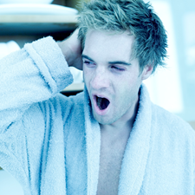
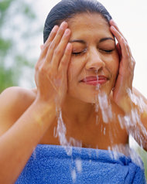

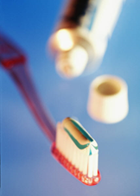
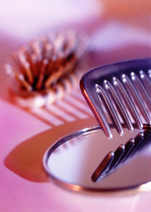
What do you do in the morning?
(Doplňte podle obrázků.)
I get up
I wash my face
I have a shower
I brush/clean my teeth
I comb/brush my hair
I have breakfast

Slide 4

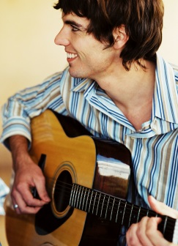
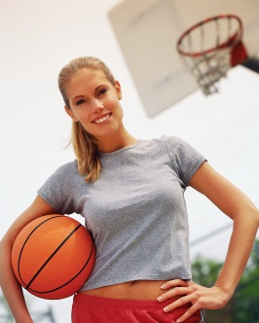
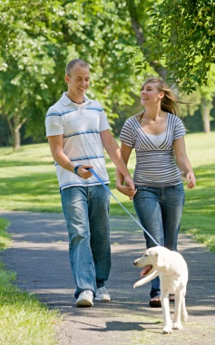
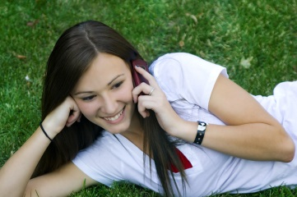
What do you do in the afternoon?
(Doplňte podle obrázků.)
I do my homework
I play the guitar
I ride my bike
I play basketball
I go for a walk
I phone with my friends

Slide 5
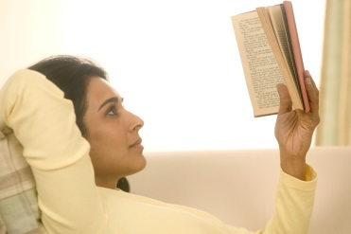
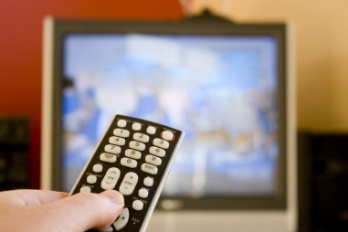
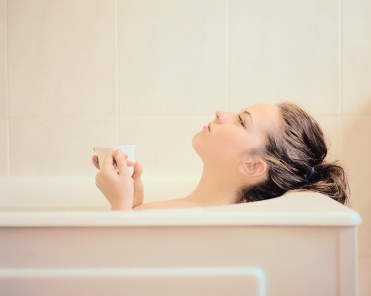
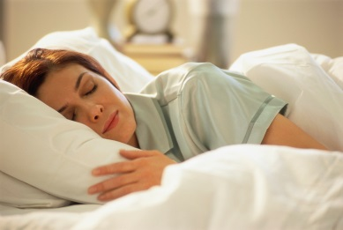
What do you do in the evening?
(Doplňte podle obrázků.)
I read a book
I watch TV
I have a bath
I go to bed

Slide 6
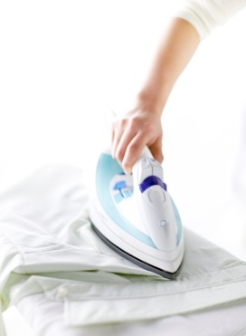
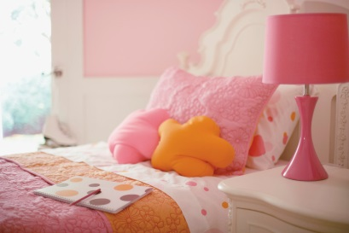
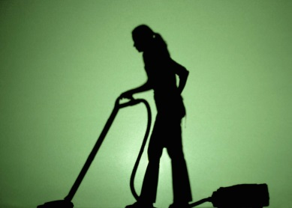
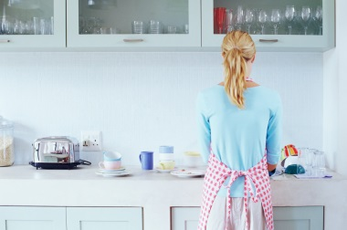
I help my mum.
(Doplňte podle obrázků.)
I make my bed
I do the ironing
I do the washing up
I do the vacuuming

Slide 7
When do you ………
(Odpovězte na otázky.)
When do you get up? I get up at ……………
When do you go to school? ……………………
When do you start school? ……………….
When do you finish school? ……………..
When do you have lunch? ……………………..
When do you come home? ……………………
When do you go to bed? ……………………....

Slide 8
Zdroje obrázků: http://office.microsoft.com

