Slide 1

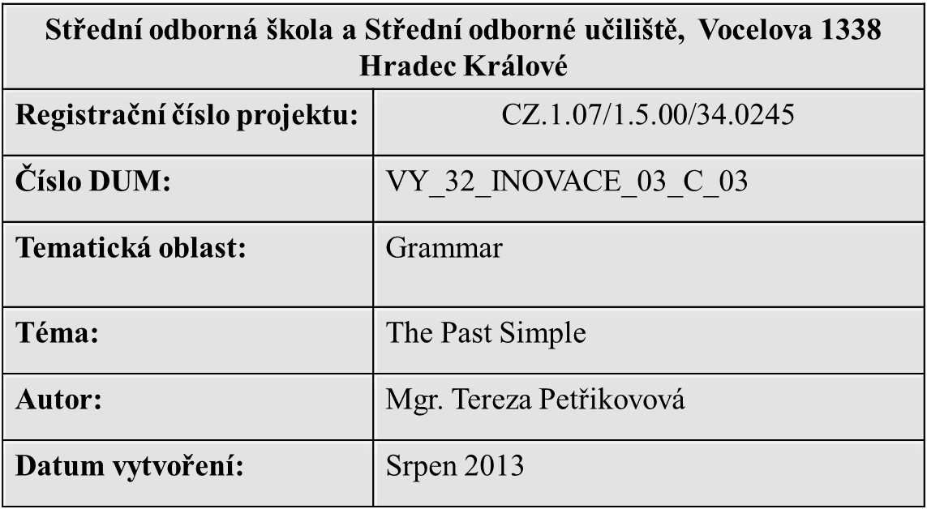

Slide 2
ANOTACE:
Anotace:
Didaktický učební materiál je určen žákům středních škol k zopakování učiva. Prezentace se skládá z přehledu daného učiva a ze cvičení určených k upevnění materiálu.
METODICKÝ POKYN:
Očekávaný výstup: pravidla užívání minulého času včetně výjimek, na základě znalosti pravidel schopnost doplnění jevu do textu a jeho užívání v mluvené řeči.

Slide 3
PAST SIMPLE

Slide 4
THE PAST SIMPLE - VERB „TO BE“
Affirmative
AFFIRMATIVE
I was at home.
You were at home
He/She was at home.
We were at home.
You were at home.
They were at home.
FORM:
1st (I) and 3rd person (he,she,it) singular we use was
2nd singular (you) and plural(we, you, they) we use were

Slide 5
The past simple „to be“
Negative
NEGATIVE FORM:
1st (I) and 3rd person (he,she,it) singular we use was not (wasn´t)
2nd singular (you) and plural(we, you, they) we use were (weren´t)
I was not (wasn´t) at home.
You were not (weren´t) at home.
He/She was not (wasn´t) at home.
We were not (weren´t) at home.
You were not (weren´t) at home.
They were not (weren´t) at home.

Slide 6
The Past simple „to BE“ qUESTION
FORM: Was/were + subject +object/place/time.?
Were you at home? Yes, I was. No, I wasn´t.
Was he/she at home? Yes, he/she was. No, he/she wasn´t.
Were you at home? Yes, we were. No, we weren´t.
Were they at home? Yes, they were. No, they weren´t.

Slide 7
THE PAST SIMPLE REGULAR VERBs affirmative
FORM: We add –ed (-d) to the verb
I played football at the weekend.
You played football at the weekend.
He/she played football at the weekend.
We played football at the weekend.
You played football at the weekend.
They played football at the weekend.

Slide 8
The past simple (ir)regular verbs
NEGATIVE
FORM: subject + did not (didn´t) + verb
I did not (didn´t) play football yesterday.
You did not (didn´t) play football yesterday.
He/she did not (didn´t) play football yesterday.
We did not (didn´t) play football yesterday.
You did not (didn´t) play football yesterday.
They did not (didn´t) play football yesterday.

Slide 9
The past simple (IR)regular verbs
Question
FORM: Did + subject + verb
Did you play volleyball yesterday?
Yes, I did. No, I didn´t.
Did he/she play volleball yesterday?
Yes, he/she did. No, he/she didn´t.
Did you play volleyball yesterday?
Yes, we did. No, we didn´t.
Did they play volleyball yesterday?
Yes, they did. No, they didn´t.

Slide 10
USE THE PAST SIMPLE
To express events, situations that happened in the past and they are finished
Christopher Columbus discovered Americe in 1492.
My brother lived in Poland for 10 years.
I was born in Germany.
The time expression is given in the sentence
I met her last Monday.
I spoke with my brother yesterday.
When I was a child, I had a cute dog.

Slide 11
USE THE PAST SIMPLE
In stories/narration where situations follow each other.
I got up at 7 o´clock this morning, had a shower, got dressed and went to school.
I came to the restaurant, sat down and waited for my friends.
Habits in the past
I didn´t play the piano.
I played football when I was six.
I studied Spanish when I was a child.

Slide 12
TRANSLATION
Kdy jsi včera přišel?
O víkendu jsem byla s kamarádkou v kině.
Proč jsi to udělal?
Můj dědeček byl doktor a pracoval v nemocnici.
Otevřel okno a zavřel dveře.
Co si měl dnes k večeři?
Hrál jsem počítačové hry celý večer.
O víkendu pršelo, ale v týdnu bylo slunečné počasí.
Minulý týden jsem nešel do školy, protože jsem byl nemocný.

Slide 13
TRANSLATION - SOLUTION
When did you come yesterday?
I was at the cinema with my friend at the weekend.
Why did you do that?
My grandpa was a doctor and he worked in a hospital.
He opened the window and closed the door.
What did you have for dinner today?
I play PC games all evening.
It was rainy at the weekend but it was sunny at week.
I didn´t go to school last week because I was ill.

Slide 14
Make questions from these sentences.
I called my mother yesterday.
My mother cooked a great meal for dinner.
My aunt worked as a teacher.
I usually had fruit for snack at school.
I was born in Prague in 1989.
My brother helped me with my homework.
I wasn´t at school, I was at home.
I danced with Jane.
My grandfather smoked five cigarettes a day.

Slide 15
QUESTIONS - SOLUTION
When did you call your mother?
What did your mother cook for dinner?
What did your aunt do?
What did you usually had for snack at school?
Where and when were you born?
Who helped you with your homework?
Where were you?
Who danced you with?
How many cigarettes did your grandfather smoke a day?

Slide 16
Answer these questions
Was your mother a cook?
Did you have a mobile phone when you were a child?
Did you have a dog?
Were you at party last night?
Did you have a job on your last holiday?
Did you get money for your birthday?
Were you in Croatia last year?
How did you go to elementary school?
Did you like your class teacher?

Slide 17
RESOURCES
Slide 3 – 16 Vlastní tvorba

