Slide 1

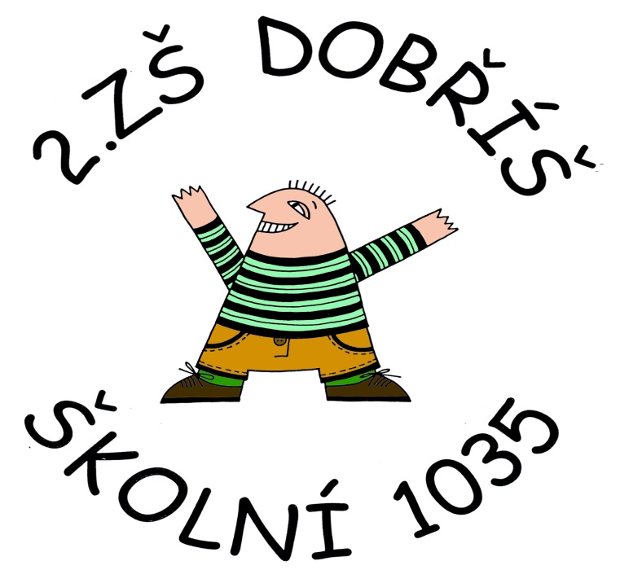
Číslo projektu | CZ.1.07/1.4.00/21.1405
Název sady materiálů | LIFE IN MY COUNTRY
Název materiálu | VY_32_INOVACE_05_Easter, symbols, Easter days
Autor | Svojtková Hana

Slide 2
EASTER
ANSWER THE QUESTIONS
CLICK FOR HELP
WHEN IS EASTER CELEBRATED?
WHAT DOES IT MEAN FOR PEOPLE?
WHAT DO PEOPLE PREPARE FOR EASTER?
ON THE FIRST SUNDAY AFTER THE FIRST SPRING FULL MOON.
IT MEANS A HOLIDAY/THE BEGINNING OF SPRING AND
THE END OF COLD WINTER WEATHER.
THEY LIKE DECORATING EGGS IN BRIGHT COLOURS.
PEOPLE LIKE TO GROW CORN IN FLOWER POTS.

Slide 3
SYMBOLS
DO YOU KNOW CZECH TRADITIONAL EASTER SYMBOLS?
MALOVANÁ VAJÍČKA
VRBOVÁ POMLÁZKA
BOCHÁNEK
PEČENÝ BERÁNEK
ZAJÍČEK, KUŘÁTKA
PAINTED EGGS
PLAITED WILLOW CANES
SWEET CAKE CALLED “MAZANEC“
SWEET CAKE IN THE SHAPE OF A LAMB CALLED “BERÁNEK“
BABY ANIMALS – RABBIT, CHICKEN
CLICK HERE FOR HELP

Slide 4
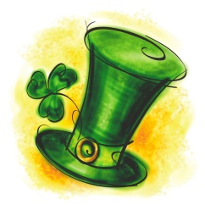
EASTER DAYS
CLICK IF YOU WANT TO FIND CORRECT WORDS
PALM SUNDAY
KVĚTNÁ NEDĚLE
ZELENÝ ČTVRTEK
VELKÝ PÁTEK
BÍLÁ SOBOTA
VELIKONOČNÍ NEDĚLE
MAUNDY THURSDAY
GOOD FRIDAY
HOLY SATURDAY
EASTER SUNDAY

Slide 5
Zdroje:
Klipart Microsoft Office
vlastní

