Slide 1

NEW ZEALAND
Škola | Katolické gymnázium Třebíč, Otmarova 22, Třebíč 674 01
Název projektu | Moderní škola
Číslo projektu | CZ.1.07/1.5.00/34.0464
Šablona | III/2 Inovace a zkvalitnění výuky prostřednictvím ICT
Autor DUM | Paula Torresan
Název DUM | New Zealand
Kód DUM | VY_32_INOVACE_ 1.1.7_New_Zealand
Datum vytvoření | 31/08/2013
Předmět | Anglický jazyk
Tematická oblast | Anglicky mluvicí země
Výstup ŠVP | Reálie anglicky mluvících zemí
Anotace DUM | PowerPoint prezentace o o Novém Zélandu (reálie).
Metodický popis | Prezentace slouží k seznámení studentů s nejdůležitějšími informacemi o Novém Zélandu.
Hodnocení | DUM přispěl k hlubšímu zapamatování či procvičení učiva.
Autor prohlašuje, že řádně uvedl všechny použité zdroje. Pokud není uvedeno jinak, použitý materiál je z vlastních zdrojů autora.

Slide 2
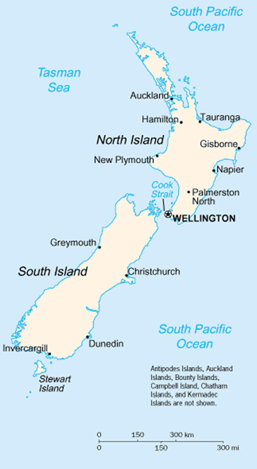
New Zealand
New Zealand map. In: Wikipedia: the free encyclopedia [online]. San Francisco (CA): Wikimedia Foundation, 2001- [cit. 2013-08-23]. Dostupné z: http://commons.wikimedia.org/wiki/File:New_Zealand_map.PNG

Slide 3
Facts and figures
New Zealand consists of a group of islands. The two biggest are North Island and South Island. The islands are separated by the Cook Strait.
Its Maori name is Aotearoa, which means “the land of the long white cloud".
It is an isolated country: Australia is 1,600 km away!
There are three official languages: English, Maori and New Zealand Sign Language.
The population is about 4,500,000.
The capital is Wellington (200,000 inhabitants), while the biggest city is Auckland (1,400,000 inhabitants). They are both situated on North Island.
New Zealanders are called “Kiwis”, after the famous bird.
The majority of the population has European descent.

Slide 4
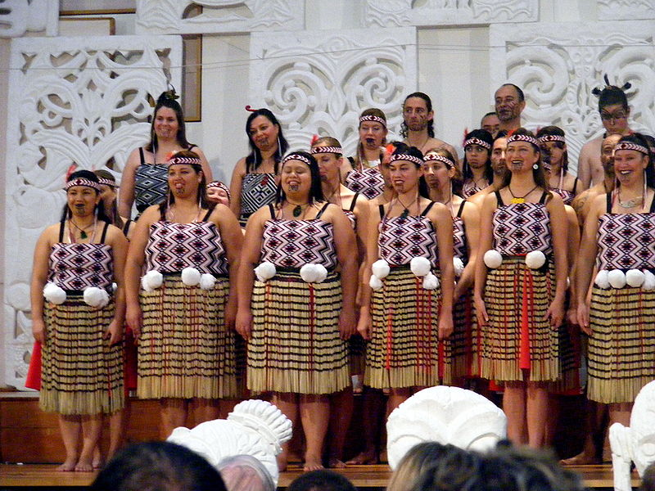
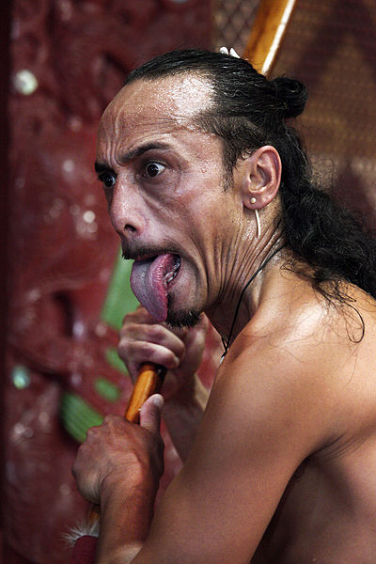
The Maoris form about 15% of the population. They originate from the Polynesian Islands and arrived around A.D. 1,000.
Left: NgatiRananaChristmas. In: Wikipedia: the free encyclopedia [online]. San Francisco (CA): Wikimedia Foundation, 2001- [cit. 2013-08-23]. Dostupné z: http://commons.wikimedia.org/wiki/File:NgatiRananaChristmas.jpg
Right: EVANS, Steve. New Zealand Maori Culture 001 (5396249586). In: Wikipedia: the free encyclopedia [online]. San Francisco (CA): Wikimedia Foundation, 2001- [cit. 2013-08-23]. Dostupné z: http://commons.wikimedia.org/wiki/File:New_Zealand_Maori_Culture_001_(5396249586).jpg

Slide 5
Geography
New Zealand has a beautiful scenery. We can find sandy beaches, pastures, snowy peaks, fjords, caves and glacial lakes.
New Zealand has more than 50 volcanoes, some of them active, and most of them can be found on North Island.
The highest mountain is Mount Cook (3,754 m.). It is part of the Southern Alps range on South Island.
The longest river is the Waikato River (425 km. long) on North Island. It empties into Lake Taupo, New Zealand’s biggest lake.
New Zealand’s economy is mainly based on tourism, wool, mutton and lamb. This has also to do with fact that on the islands live more sheep than people!

Slide 6
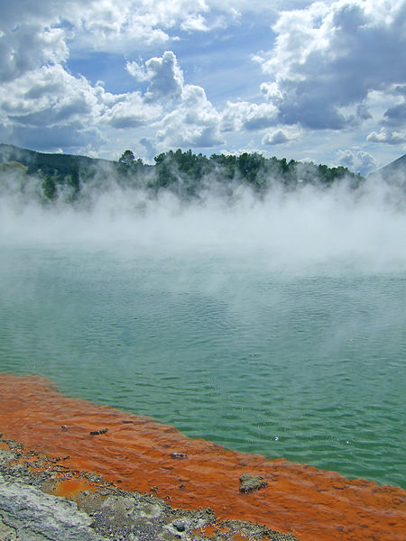
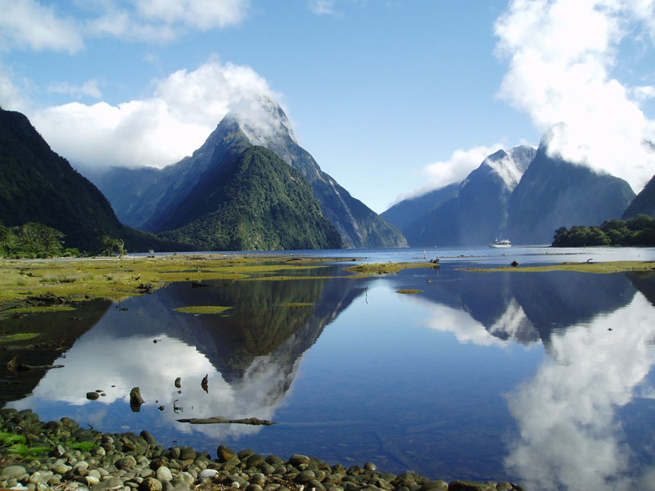
Famous tourist destinations
On North Island, Rotorua is famous for its geothermal activity, with geysers and hot bubbling mud pools.
Milford Sound is the most famous fjord and it’s situated on South Island.
Left: GEECEE75. Geothermal pools, Rotorua, New Zealand-01. In: Wikipedia: the free encyclopedia [online]. San Francisco (CA): Wikimedia Foundation, 2001- [cit. 2013-08-23]. Dostupné z: http://commons.wikimedia.org/wiki/File:Geothermal_pools,_Rotorua,_New_Zealand-01.jpg
Right: OLYWYER. Milford sound Nouvelle Zélande 03 mars 2005. In: Wikipedia: the free encyclopedia [online]. San Francisco (CA): Wikimedia Foundation, 2001- [cit. 2013-08-23]. Dostupné z: http://commons.wikimedia.org/wiki/File:Milford_sound_Nouvelle_Zélande_03_mars_2005.jpg

Slide 7
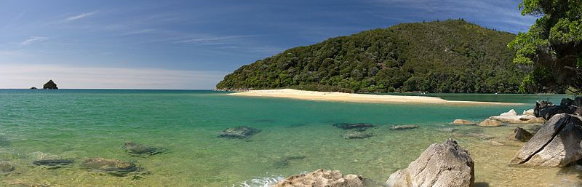
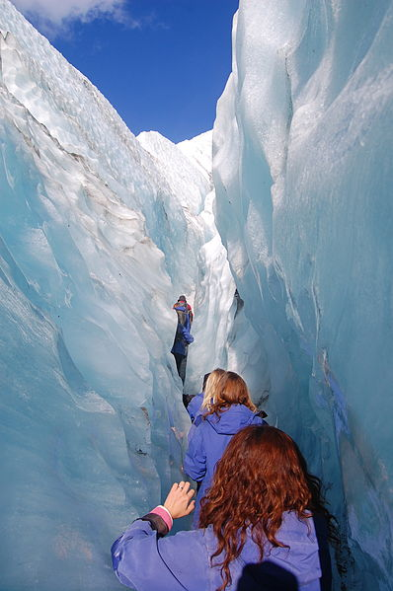
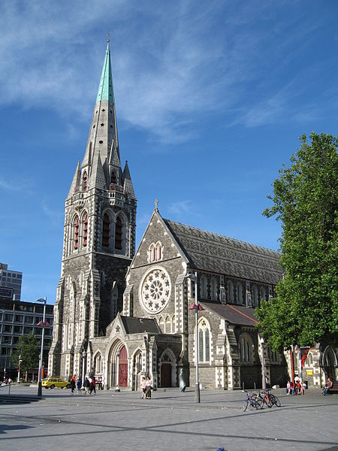
Abel Tasman NP. People can camp, sightsee and kayak in the park.
SÁNCHEZ PORTERO, Javier. Sandfly Bay. In: Wikipedia: the free encyclopedia [online]. San Francisco (CA): Wikimedia Foundation, 2001- [cit. 2013-08-23]. Dostupné z: http://commons.wikimedia.org/wiki/File:Sandfly_Bay.jpg
An helicopter tour takes tourists to Franz Joseph Glacier. It is possible to walk onto it.
EDWIN.11. Franz Josef Glacier (4673939965). In: Wikipedia: the free encyclopedia [online]. San Francisco (CA): Wikimedia Foundation, 2001- [cit. 2013-08-23]. Dostupné z: http://commons.wikimedia.org/wiki/File:Franz_Josef_Glacier_(4673939965).jpg
Christchurch is the largest city on South island and has been called "the most English city outside England."
O'BEIRNE, Greg. ChristChurchCathedral1 gobeirne. In: Wikipedia: the free encyclopedia [online]. San Francisco (CA): Wikimedia Foundation, 2001- [cit. 2013-08-23]. Dostupné z: http://commons.wikimedia.org/wiki/File:ChristChurchCathedral1_gobeirne.jpg

Slide 8
Nature
Due to its isolation, New Zealand has unique wildlife.
Endemic species are the kiwi, the kakapo, the tuatara and the giant weta.
Nearly all the birds have lost the ability to fly as there were no predators on the island.
Nowadays, many animals are endangered by the animals which were introduced by the Europeans and by deforestation.

Slide 9
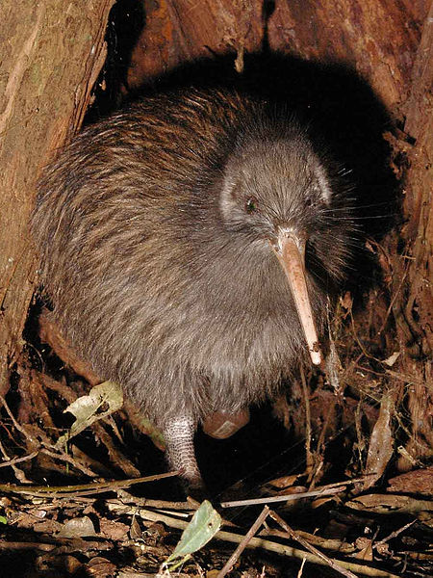
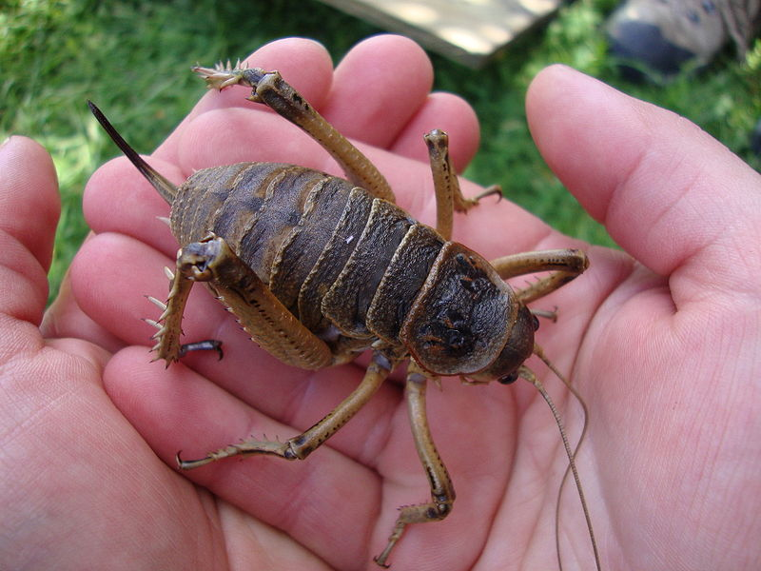
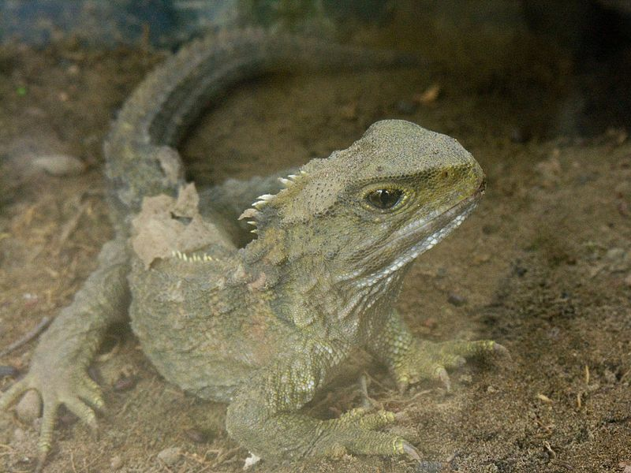
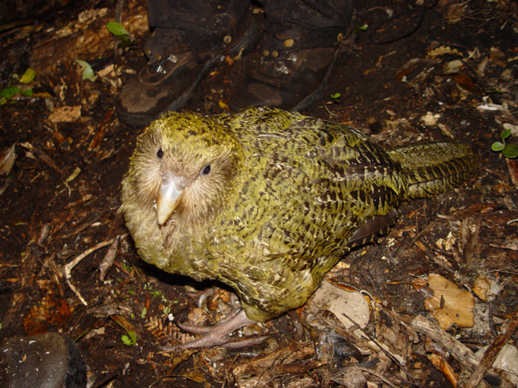
Kiwi
MAUNGATAUTARI ECOLOGICAL ISLAND TRUST. TeTuatahianui. In: Wikipedia: the free encyclopedia [online]. San Francisco (CA): Wikimedia Foundation, 2001- [cit. 2013-08-23]. Dostupné z: http://en.wikipedia.org/wiki/File:TeTuatahianui.jpg
Giant Weta WVERMAAT. Deinacrida rugosa NZ. In: Wikipedia: the free encyclopedia [online]. San Francisco (CA): Wikimedia Foundation, 2001- [cit. 2013-08-23]. Dostupné z: http://commons.wikimedia.org/wiki/File:Deinacrida_rugosa_NZ.jpg
Tuatara
Sphenodon punctatus in Waikanae, New Zealand. In: Wikipedia: the free encyclopedia [online]. San Francisco (CA): Wikimedia Foundation, 2001- [cit. 2013-08-23]. Dostupné z: http://en.wikipedia.org/wiki/File:Sphenodon_punctatus_in_Waikanae,_New_Zealand.jpg
Kakapo
MNOLF. Strigops habroptilus 1. In: Wikipedia: the free encyclopedia [online]. San Francisco (CA): Wikimedia Foundation, 2001- [cit. 2013-08-23]. Dostupné z: http://en.wikipedia.org/wiki/File:Strigops_habroptilus_1.jpg

Slide 10
History
The first European to discover the islands was the Dutch explorer Abel Tasman in 1642, but he was soon followed by James Cook, who took control of the island in the name of the British crown.
New Zealand became a Dominion in 1907.
It gained independence in 1947.
It is a constitutional monarchy, in fact a parliamentary democracy with a government based on the British system. It has got only one chamber, the House of Representatives. The Head of State is Queen Elizabeth II, who is represented by a Governor General.

Slide 11
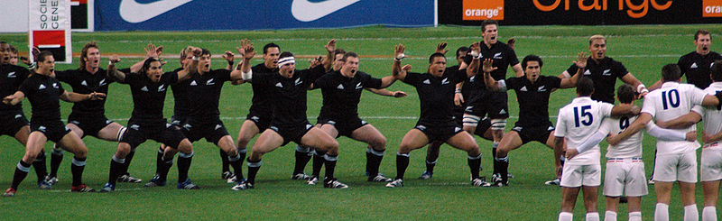
Sports
The most popular sport is rugby, and the famous national team is called All Blacks.
Other popular sports with British origins are golf, netball, cricket, horseracing.
New Zealand is also known for its extreme sports, like bungee jumping and ice-climbing, and also mountaineering.
HILLS, Sonya & Jason. All Blacks Haka. In: Wikipedia: the free encyclopedia [online]. San Francisco (CA): Wikimedia Foundation, 2001- [cit. 2013-08-23]. Dostupné z: http://en.wikipedia.org/wiki/File:All_Blacks_Haka.jpg

Slide 12
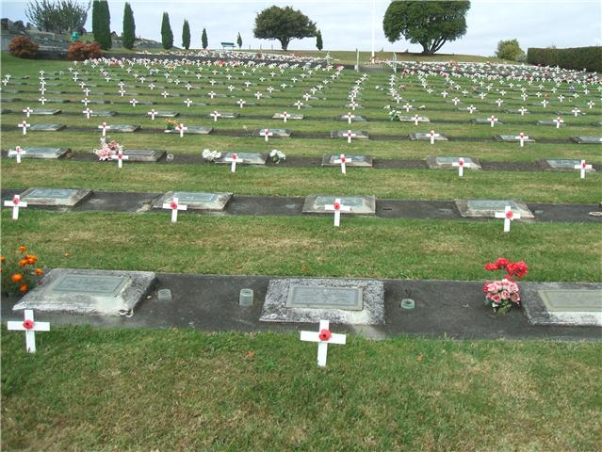
Holidays
On 6 February New Zealanders celebrate the Treaty of Waitangi between the British and the Maoris signed in 1840.
Anzac Day, on 25 April, commemorates all those who died in the two world wars.
SUBRITZKY, Mike. Anzac Day 1. In: Wikipedia: the free encyclopedia [online]. San Francisco (CA): Wikimedia Foundation, 2001- [cit. 2013-08-23]. Dostupné z: http://en.wikipedia.org/wiki/File:Anzac_Day_1.jpg

Slide 13
Použitý materiál
Článek:
New Zealand. In: Wikipedia: the free encyclopedia [online]. San Francisco (CA): Wikimedia Foundation, 2001- [cit. 2013-08-23]. Dostupné z: http://en.wikipedia.org/wiki/New_Zealand#Geography
Obrázky:
New Zealand map. In: Wikipedia: the free encyclopedia [online]. San Francisco (CA): Wikimedia Foundation, 2001- [cit. 2013-08-23]. Dostupné z: http://commons.wikimedia.org/wiki/File:New_Zealand_map.PNG
NgatiRananaChristmas. In: Wikipedia: the free encyclopedia [online]. San Francisco (CA): Wikimedia Foundation, 2001- [cit. 2013-08-23]. Dostupné z: http://commons.wikimedia.org/wiki/File:NgatiRananaChristmas.jpg
EVANS, Steve. New Zealand Maori Culture 001 (5396249586). In: Wikipedia: the free encyclopedia [online]. San Francisco (CA): Wikimedia Foundation, 2001- [cit. 2013-08-23]. Dostupné z: http://commons.wikimedia.org/wiki/File:New_Zealand_Maori_Culture_001_(5396249586).jpg
GEECEE75. Geothermal pools, Rotorua, New Zealand-01. In: Wikipedia: the free encyclopedia [online]. San Francisco (CA): Wikimedia Foundation, 2001- [cit. 2013-08-23]. Dostupné z: http://commons.wikimedia.org/wiki/File:Geothermal_pools,_Rotorua,_New_Zealand-01.jpg
OLYWYER. Milford sound Nouvelle Zélande 03 mars 2005. In: Wikipedia: the free encyclopedia [online]. San Francisco (CA): Wikimedia Foundation, 2001- [cit. 2013-08-23]. Dostupné z: http://commons.wikimedia.org/wiki/File:Milford_sound_Nouvelle_Zélande_03_mars_2005.jpg
SÁNCHEZ PORTERO, Javier. Sandfly Bay. In: Wikipedia: the free encyclopedia [online]. San Francisco (CA): Wikimedia Foundation, 2001- [cit. 2013-08-23]. Dostupné z: http://commons.wikimedia.org/wiki/File:Sandfly_Bay.jpg
EDWIN.11. Franz Josef Glacier (4673939965). In: Wikipedia: the free encyclopedia [online]. San Francisco (CA): Wikimedia Foundation, 2001- [cit. 2013-08-23]. Dostupné z: http://commons.wikimedia.org/wiki/File:Franz_Josef_Glacier_(4673939965).jpg
O'BEIRNE, Greg. ChristChurchCathedral1 gobeirne. In: Wikipedia: the free encyclopedia [online]. San Francisco (CA): Wikimedia Foundation, 2001- [cit. 2013-08-23]. Dostupné z: http://commons.wikimedia.org/wiki/File:ChristChurchCathedral1_gobeirne.jpg
MAUNGATAUTARI ECOLOGICAL ISLAND TRUST. TeTuatahianui. In: Wikipedia: the free encyclopedia [online]. San Francisco (CA): Wikimedia Foundation, 2001- [cit. 2013-08-23]. Dostupné z: http://en.wikipedia.org/wiki/File:TeTuatahianui.jpg
WVERMAAT. Deinacrida rugosa NZ. In: Wikipedia: the free encyclopedia [online]. San Francisco (CA): Wikimedia Foundation, 2001- [cit. 2013-08-23]. Dostupné z: http://commons.wikimedia.org/wiki/File:Deinacrida_rugosa_NZ.jpg
Sphenodon punctatus in Waikanae, New Zealand. In: Wikipedia: the free encyclopedia [online]. San Francisco (CA): Wikimedia Foundation, 2001- [cit. 2013-08-23]. Dostupné z: http://en.wikipedia.org/wiki/File:Sphenodon_punctatus_in_Waikanae,_New_Zealand.jpg
MNOLF. Strigops habroptilus 1. In: Wikipedia: the free encyclopedia [online]. San Francisco (CA): Wikimedia Foundation, 2001- [cit. 2013-08-23]. Dostupné z: http://en.wikipedia.org/wiki/File:Strigops_habroptilus_1.jpg
HILLS, Sonya & Jason. All Blacks Haka. In: Wikipedia: the free encyclopedia [online]. San Francisco (CA): Wikimedia Foundation, 2001- [cit. 2013-08-23]. Dostupné z: http://en.wikipedia.org/wiki/File:All_Blacks_Haka.jpg
SUBRITZKY, Mike. Anzac Day 1. In: Wikipedia: the free encyclopedia [online]. San Francisco (CA): Wikimedia Foundation, 2001- [cit. 2013-08-23]. Dostupné z: http://en.wikipedia.org/wiki/File:Anzac_Day_1.jpg

