Slide 1


Číslo projektu | CZ.1.07/1.5.00/34.0029
Číslo materiálu | VY_32_INOVACE_14_20
Název školy | Střední průmyslová škola stavební, Resslova 2, České Budějovice
Autor | Mgr. Jan Mužík
Tematický celek | Anglický jazyk odborný: WORK EXPERIENCE AT SECONDARY TECHNICAL SCHOOL OF CIVIL ENGINEERING
Ročník | 3.-4.
Datum tvorby | 1.12. 2013
Anotace | Žáci se naučí vyprávět o praxi na odborné škole. Možné použít i pro 3. (školní) část ústní maturitní zkoušky.
Metodický pokyn | Žáci sledují prezentaci. Učitel čte otázky, žáci zkoušejí odpovědi. Pak učitel po kliknutí spustí modelovou odpověď. Žáci ji zopakují, a zkoušejí jiné varianty odpovědi. Učitel pak může zadat na dané téma slohovou práci.
Pokud není uvedeno jinak, použitý materiál je z vlastních zdrojů autora

Slide 2
Work Experience at Secondary Technical School of Civil Engineering
Praxe studentů
na střední průmyslové škole stavební

Slide 3
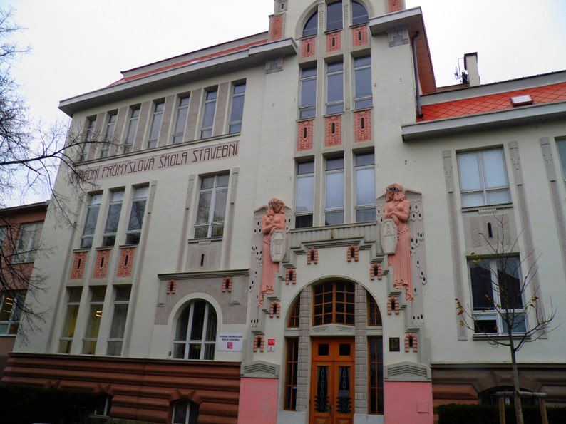
Secondary Technical School of Civil Engineering České Budějovice

Slide 4
You are going to speak about:
The company you worked for
The work you did
The tools, instruments and machines you worked with
The other people in the workplace
The routine
Your experience

Slide 5
About the company:
Who did you work for?
  I worked for a company called XYZ.
What does the company do?
  They build houses and restore historical buildings.
What do they specialize in?
  They specialize in the construction of railway bridges.

Slide 6
About the company:
Where are they based?
  The head office is in Velešín.
Where do they operate?
  They work all over the Czech Republic.
Why did you choose to work for them?
  Because the joinery is owned by my uncle. Because I love …

Slide 7
About the work:
What did you do?
I built walls/ helped the roofers/ mixed cement/ drove a forklift/ swept the floor.
What were you responsible for?
I was responsible for a team of 4 students.
Did you enjoy the job?
Yes, I did. It was very interesting.
No, I didn‘t. I was bored.

Slide 8
About the tools, …
What tools did you work with?
  I worked with a wheelbarrow, a ladder, a trowel, a shovel and other tools.
What instruments did you use?
  We used surveying instruments like a total station and a laser tracker.
What machines did you work with?
  I worked with a cement mixer, a bulldozer and a chainsaw.

Slide 9
About the other people in the workplace
Who did you report to?
  I reported to Mr. Novák, the foreman.
Who did you work with?
  There were boys and girls from my class and a team of 5 concrete workers.
Did you get on well with them?
  Yes, I did. They were all very nice, but the manager was very rude.

Slide 10
About the routine:
What was your typical day like?
  We started work at 6:30 every day.
  First, we changed into work clothes.
  Then, the teacher/ site agent briefed us about the day‘s work.
  There was a lunch break at 12 o‘clock.
  We finished work at 4 p.m.
  At the end of the day, we had to clean the tools.

Slide 11
About the routine:
Did you have to travel to work?
  Yes, I did. No, I didn‘t.
How did you get there?
  My dad drove me to work in the morning, after work I took a bus.
How far?
  It was about 25 km from my home.

Slide 12
About the routine:
How much time did it take you?
  It took me about 20 min to get there.
Did you have to work overtime/at weekends/at night/in shifts?
  Yes, I sometimes had to work on Saturdays.

Slide 13
About your overal experience
How did you find the work? Was it …
  tiring?
  Yes, I was very tired at the end of the shift.
  interesting?
    No, I didn‘t learn anything new.
  boring?
    No, not at all. It was exciting.
  dangerous?
    Yes, I had to wear safety glasses.

Slide 14
About the salary/wages
Did you earn any money?
  Yes, I did.
How much?
  I earned CZK 5,000.
What did you do with it?
  I bought new skis and a helmet.
If you didn’t earn any money, why?
  Because it was an unpaid school work experience.

Slide 15
About the satisfaction:
What did you enjoy/ love/ hate/ don´t like doing?
  I enjoyed working with the crane.
  I hated sweeping the floor.
Can you imagine doing this job in the future?
  No, never.
  Yes, actually I‘m going to work for them next summer again.

Slide 16
Autor:
Mgr. Jan Mužík
SPŠ stavební České Budějovice
muzik@stavarna.eu
Fotografie vlastní

