Slide 1

Název školy: Základní škola Chomutov, Písečná 5144
Název materiálu: VY_22_INOVACE_34_Minimundus - round the World 2_hz2
Číslo projektu: CZ 1.07/1.4.00/21.3355
Autor: Mgr. Zdena Hanušová
Datum tvorby: 25.1.2014
Cílový ročník: 6. ročník
Vzdělávací oblast: Anglický jazyk
Klíčové slovo: klenotnice, chrám, hrad, katedrála, mešita.
Anotace: Prezentace fotografií z Minimundusu.
Autorem materiálu a všech jeho částí, není-li uvedeno jinak,
je Mgr. Zdena Hanušová.
Financováno z ESF a státního rozpočtu ČR.

Slide 2
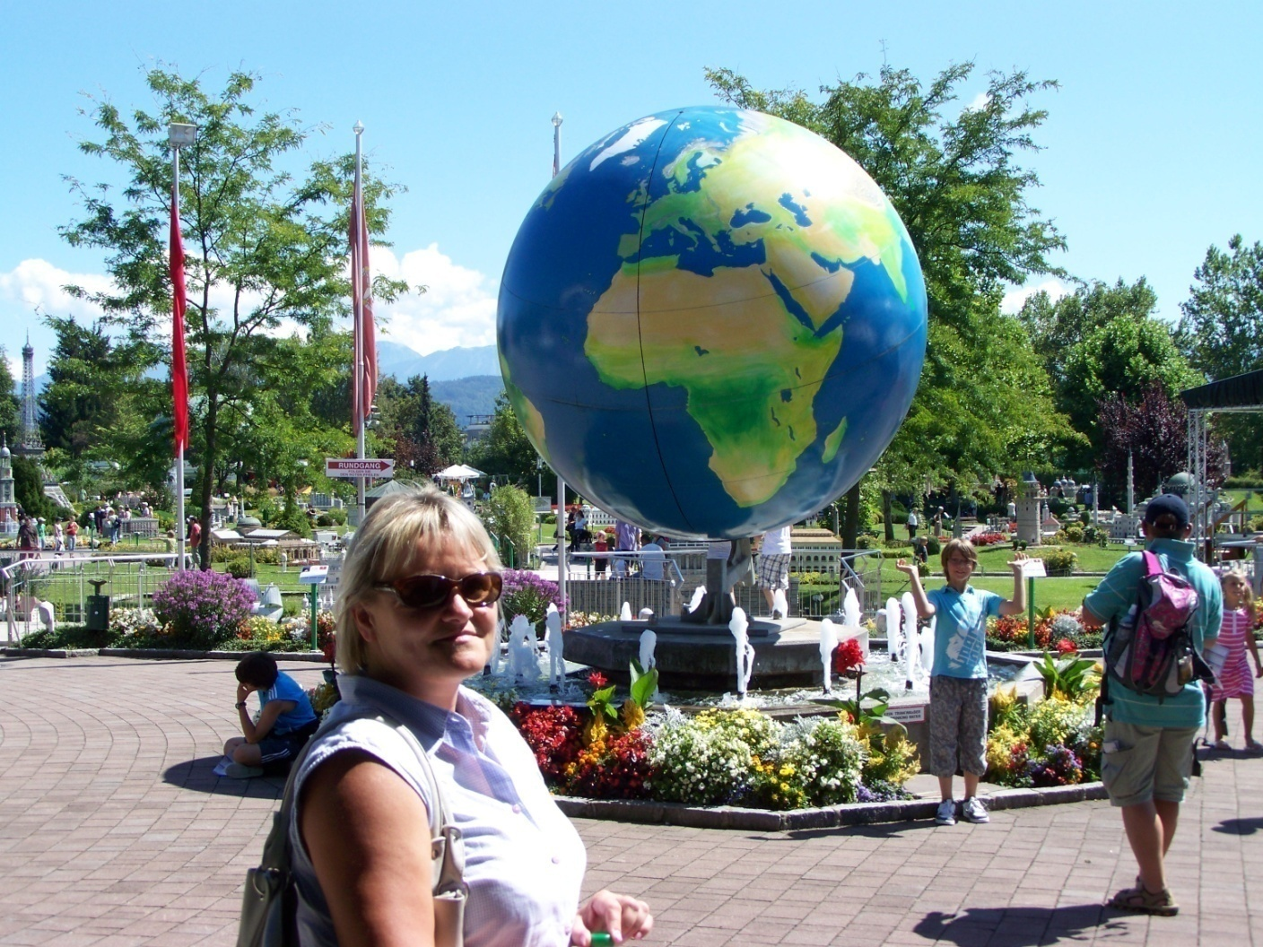
Minimundus - round the World 2.

Slide 3
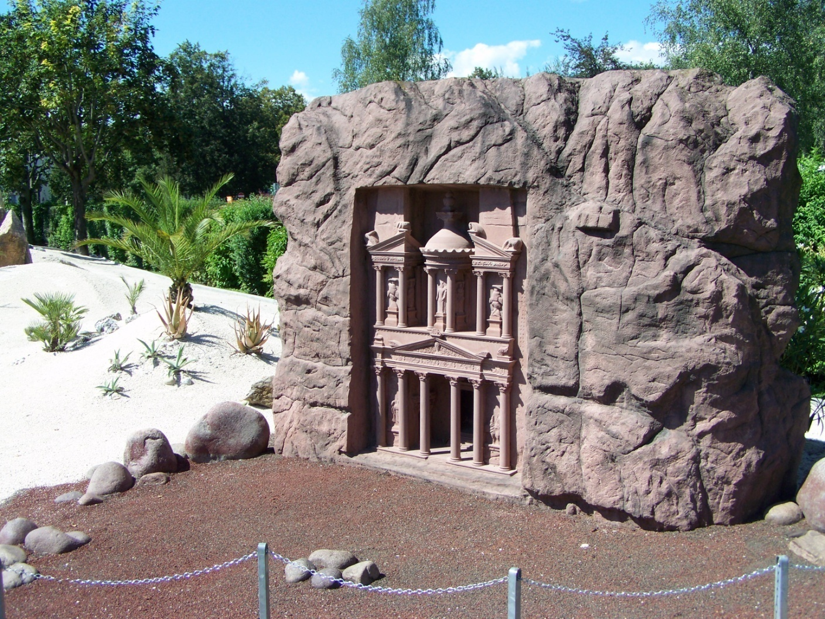
The Treasury of Petra - Jordan.
The construction was carved in a single piece of red rocks.

Slide 4
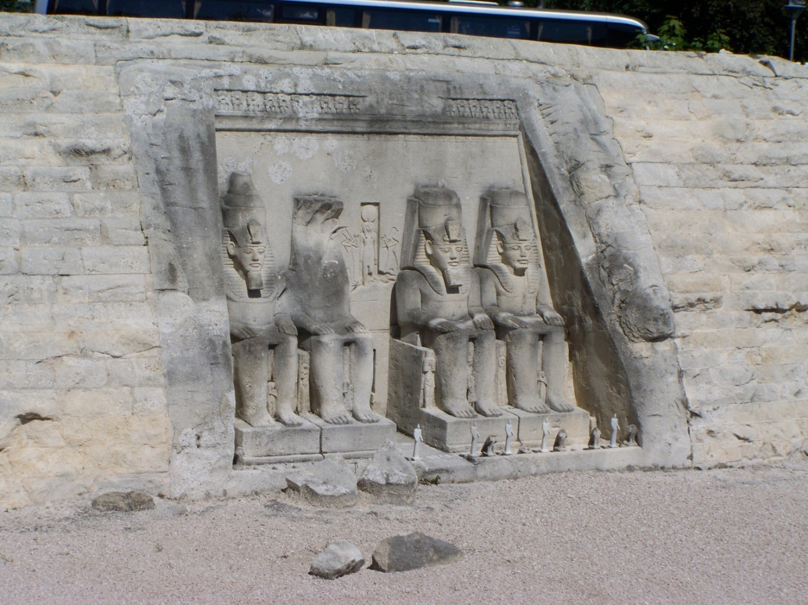
Abu Simbel.
The temple was dedicated to the gods of Upper and Lower Egypt. The entrance to the temple are dominated four high seated statues of Ramesses II.

Slide 5
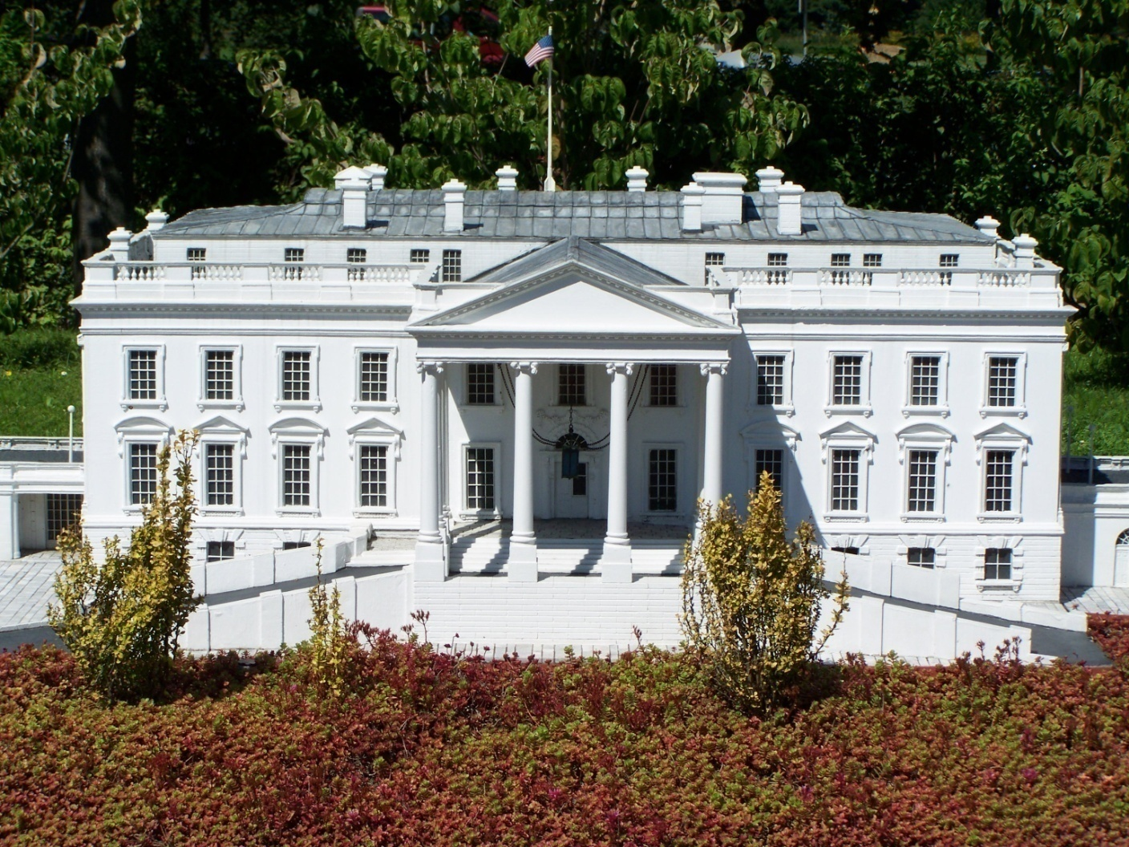
The White House - Washington.
The White House is the official residence and workplace of the President of the United States of America.

Slide 6
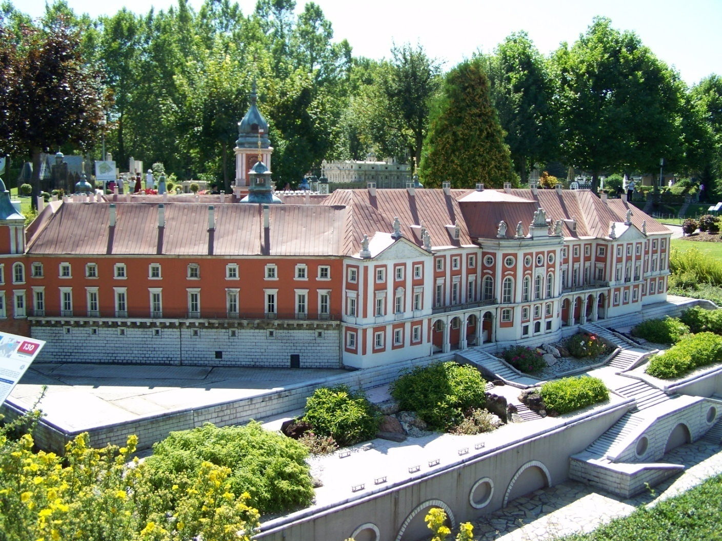
Royal Castle in Warsaw.
It's a royal palace, and there was the official residence of the Polish monarchs. Today it serves as the headquarters of the National Museum.

Slide 7
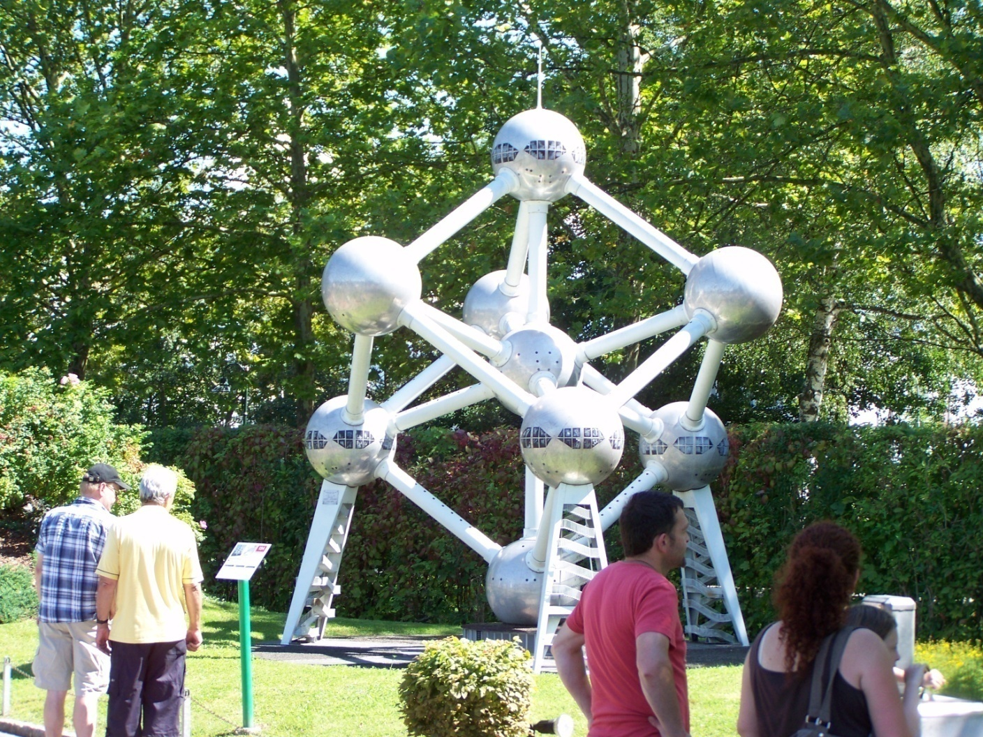
Atomium.
This building is in Brussels. It is 120 m high and offers beautiful views of the city.

Slide 8
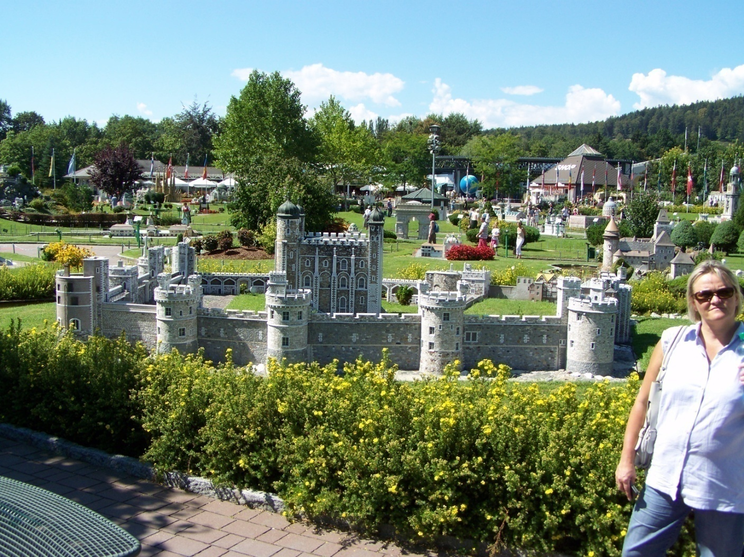
Tower - London.
White Tower - a square building with a tower at each corner of the fort gave this name.

Slide 9
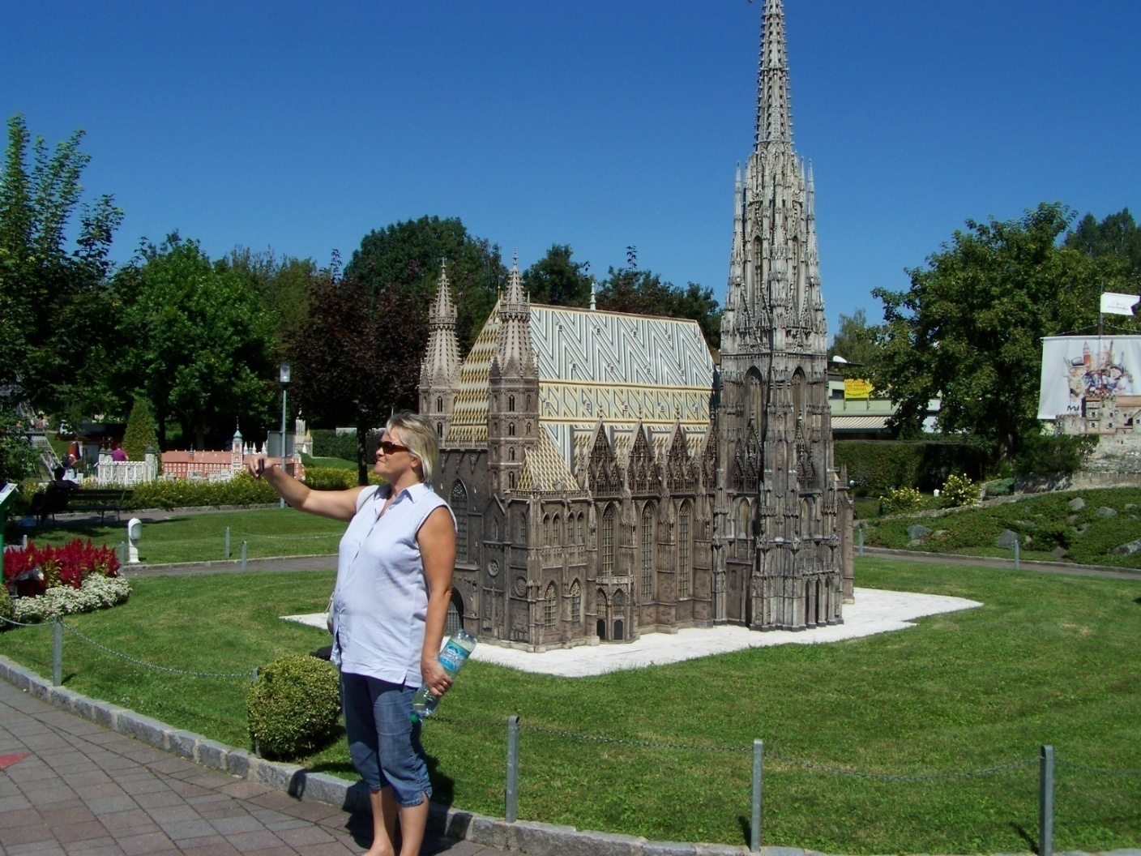
St. Stephen's Cathedral in Vienna.
It is one of the most important Austrian Gothic monuments.
The bishop lives there since 1469.

Slide 10
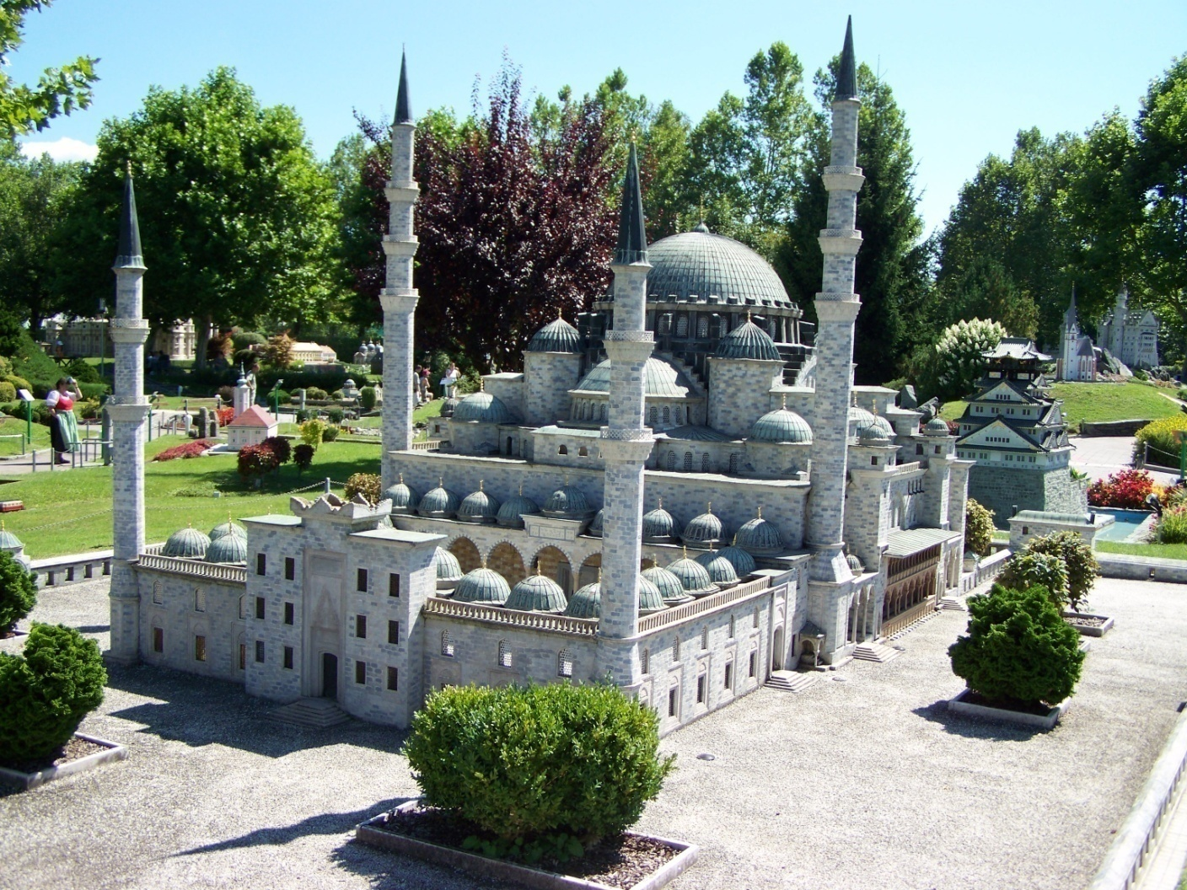
Historical Mosque in Istanbul.
It is the largest mosque in the city, which alone has six minarets.

Slide 11
(2014 – 01 – 25)
Zdroje: vlastní archiv autorky

