Slide 2
Who is who?
He is ……….
She is………

Slide 3

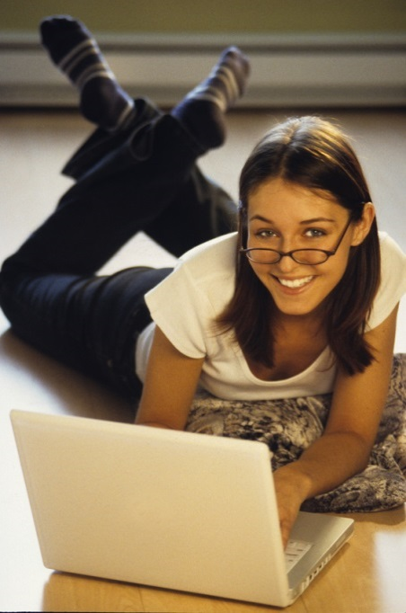
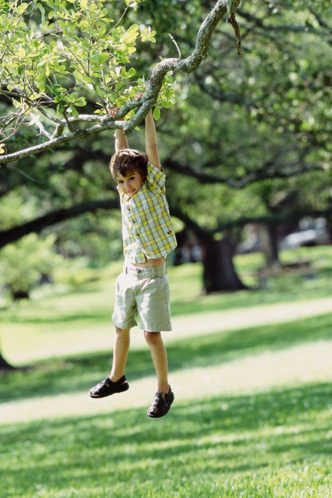
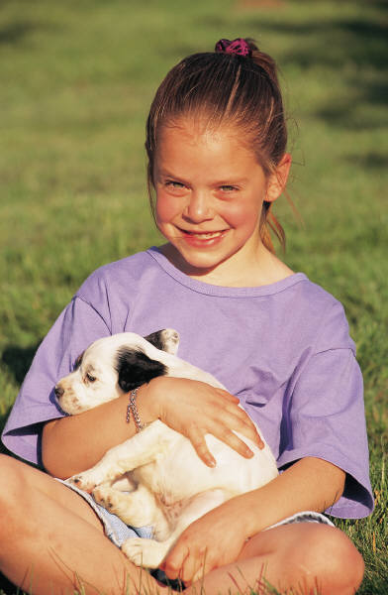
Přečti a spoj se správným obrázkem.
She is a girl.
He is a boy.
She is a woman.
He is a man.
She has got glasses.
He has got black hair.
He has got shorts.
She has got a dog.
He is in the street.
She is in the garden.
He is in the park.
She is at home.

Slide 4
Přečti a spoj se správným obrázkem - řešení
She is a girl.
He is a boy.
She is a woman.
He is a man.
She has got glasses.
He has got black hair.
He has got shorts.
She has got a dog.
He is in the street.
She is in the garden.
He is in the park.
She is at home.

Slide 5
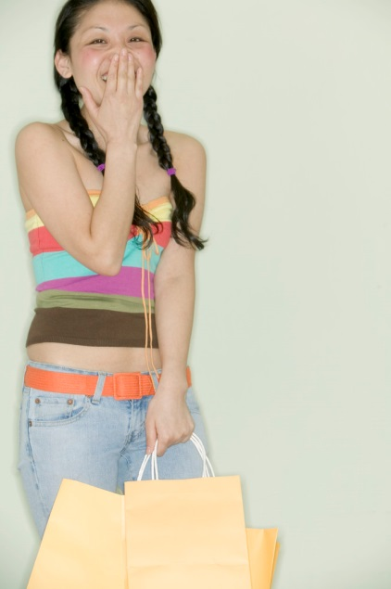
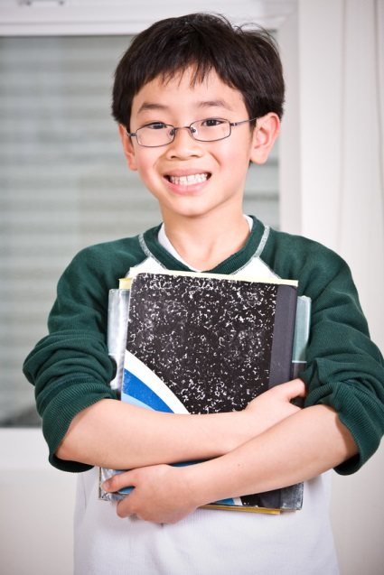
Napiš anglicky:
Ona je dívka. ………………………………………………………………………
Ona má dlouhé vlasy. ……………………………………………………………..
Ona má tašky. …………………………………………………………………………
Ona je v obchodě. …………………………………………………………………….
On je chlapec. …………………………………………………………………..........
On má brýle. ……………………………………………………………………………
On má knihy. …………………………………………………………………………….
On je ve škole. …………………………………………………………………………

Slide 6
Napiš anglicky: řešení
Ona je dívka. She is a girl.
Ona má dlouhé vlasy. She has got long hair.
Ona má tašky. She has got bags.
Ona je v obchodě. She is in the shop.
On je chlapec. He is a boy.
On má brýle. He has got glasses.
On má knihy. He has got books.
On je ve škole. He is in the school.

Slide 7
Použité zdroje:
Zdroj všech obrázků je galerie Microsoft Office 2010,
vlastník licence ZŠ Jablonec nad Nisou – Mšeno, Mozartova24,
příspěvková organizace

