Slide 1

VY_32_INOVACE_239_Fruit
Identifikátor školy: 600 150 569
Šablona

Slide 2
Fruit

Slide 3
Something about me…
My name is --- .
I am --- years old.
I am from the Czech Republic.
I live in --- .
My favourite colour is --- .
I like --- .
I am good at --- .
I am interested in ---.

Slide 4
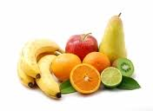
Something about fruit
I am talking about fruit.
I like fruit.
My favourite fruit is oranges, apples, strawberries and bananas.
I think that fruit is healthy and it has vitamins.
I know a lot of fruit.
In our republic we have new kinds of fruit.

Slide 5
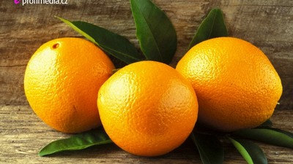
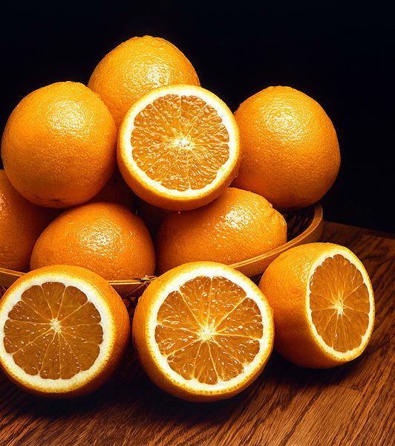
Oranges
I am talking about oranges.
Oranges are orange and very juicy.
They are sweet or sour.
Oranges grow on trees.
They contain vitamin C.
They come from China and Vietnam.

Slide 6
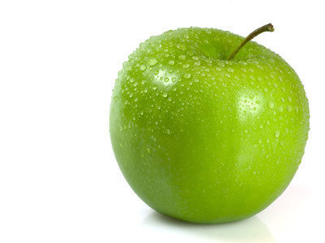
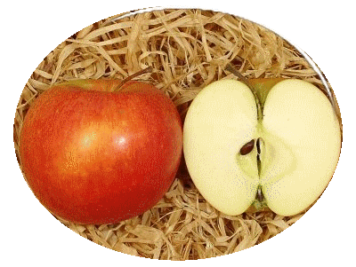
Apples
I am talking about apples.
Apples are green and red.
Apple juice can be done from apples.
I like apple juice.
They contain vitamin C as oranges.

Slide 7
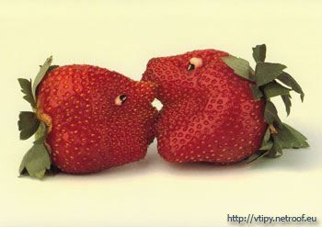
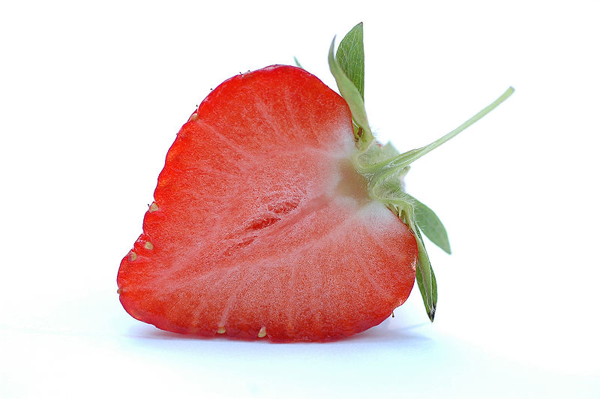
Strawberries
I am talking about strawberries.
I like strawberries.
My uncle drinks strawberry juice.
I don´t like canned strawberries. I like strawberries from our garden.

Slide 8
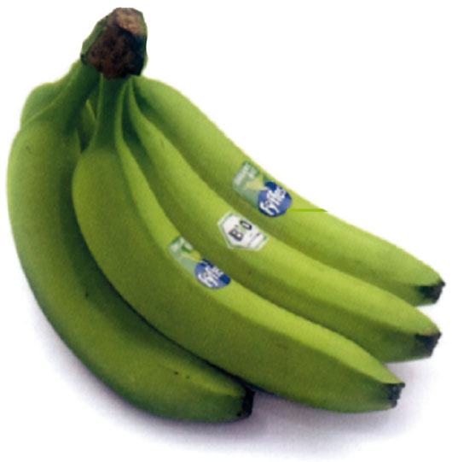
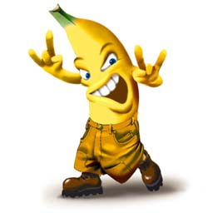
Bananas
I am talking about bananas.
I don´t like banana juice.
Bananas are yellow or green.
They grow on trees.
I like bananas with cocoa.
My mum doesn´t like bananas. She only drinks banana cocktails.

Slide 9
Addresses of images from the internet
http://www.google.cz/imghp?hl=cs&tab=Ti&q=Adresi%20obr%C3%A1zk%C5%AF%20z%20internetu.
http://cs.wikipedia.org/wiki/Hlavn%C3%AD_strana

