Slide 1

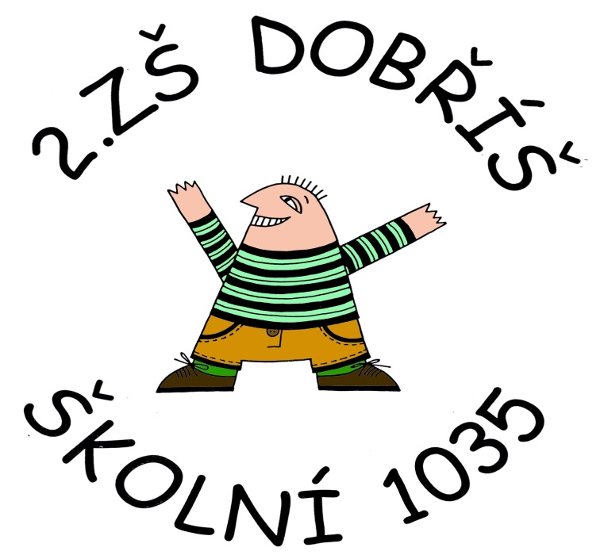
History of the town, castle, church
History of the town, castle, church
Číslo projektu | CZ.1.07/1.4.00/21.1405
Název sady materiálů | MY COUNTRY
Název materiálu | VY_32_INOVACE_01_The official name, people, area
Autor | Svojtková Hana

Slide 2
THE OFFICIAL NAME
WHAT IS THE OFFICIAL NAME OF THE COUNTRY?
THE CZECH REPUBLIC
THE CZECH LANDS

Slide 3
PEOPLE
HOW MANY PEOPLE LIVE HERE?
6,5 milion inhabitants
10,3 milion inhabitants
16 milion inhabitants

Slide 4
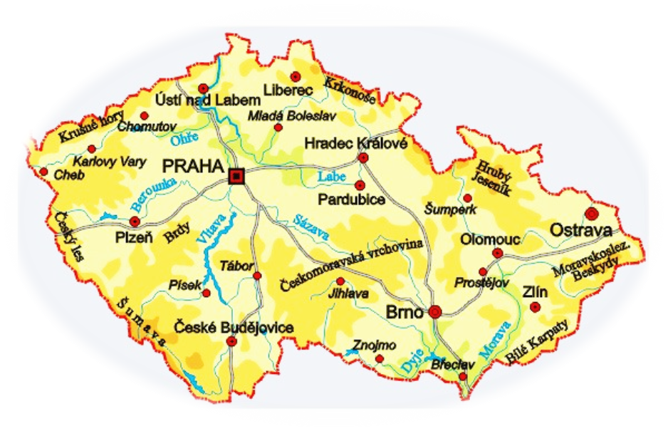
AREA
COVERING AN AREA OF
78,867 sq km

Slide 5
Zdroje:
www.treking.cz/mapy/ceska-republika.jpg
Klipart Microsoft Office
vlastní

