Slide 1

NÁZEV: VY_32_INOVACE_3.2.6.2. O 09
NÁZEV ŠKOLY: Základní škola Strančice, okres Praha - východ
AUTOR: Mgr. Lenka Kulhavá
TEMA: Angličtina
ČÍSLO PROJEKTU:
CZ.1.07/1.4.00/21.2976

Slide 2
ANOTACE:
Prezentace je určena pro žáky 8. a 9. tříd ZŠ k procvičení tématu „U zubaře“.
V první části si žáci přečtou rozhovory a slovní zásobu týkající se modelových situací u zubaře, jako je dialog na recepci, u dentisty, řešení způsobu léčby, apod.
Další část zahrnuje různé dialogy, které mohou posloužit v dalších hodinách na opakování daného tématu nebo k jeho většímu procvičení.
Výsledkem prezentace by měl být samostatně vytvořený rozhovor mezi žáky na dané téma.

Slide 3
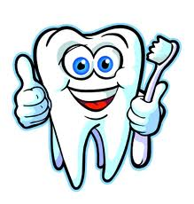
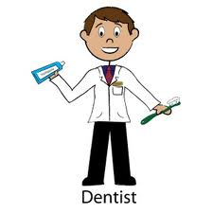
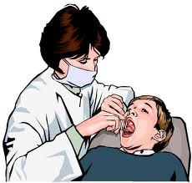
AT THE DENTIST´S
Lenka Kulhavá

Slide 4
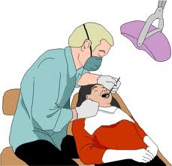
AT THE DENTIST´S
At the reception
Can I make an appointment to see the dentist/hygienist?
I'd like a check-up.
Please take a seat.
Would you like to come through?
Having your teeth examined
When did you last visit the dentist?
Have you had any problems?
I've got toothache.
One of my fillings has come out.
I've chipped a tooth.
I'd like a clean and polish, please.
Can you open your mouth, please?
A little wider, please.
I'm going to give you an x-ray.
You've got a bit of decay in this one.
You've got an abscess.

Slide 5
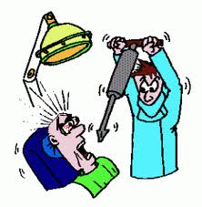
Dental treatment
You need two fillings.
I'm going to have to take this tooth out.
Do you want to have a crown fitted?
I'm going to give you an injection.
Let me know if you feel any pain.
Would you like to rinse your mouth out?
You should make an appointment with the hygienist.
How much will it cost?

Slide 6
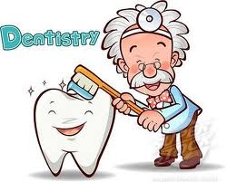
Dental Receptionist Sam: Good morning. I have an appointment with Dr. Peterson at 10.30.
Receptionist: Good morning, can I have your name, please?
Sam: Yes, it's Sam Waters.
Receptionist: Yes, Mr. Waters. Is this the first time you've seen Dr. Peterson?
Sam: No, I had my teeth cleaned and checked last year.
Receptionist: OK, just a moment, I'll get your chart.
Sam: Oh, I changed my insurance. Here's my new provider card.
Receptionist: Thank you. Is there anything in particular you'd like the dentist to check today?
Sam: Well, yes. I've been having some gum pain recently.
Receptionist: Alright, I'll make a note of that.
Sam: ... and I'd like to have my teeth cleaned as well.
Receptionist: Of course, Mr. Waters, that'll be part of today's dental hygiene.
Sam: Oh, yes, of course.
Receptionist: Please have a seat and the Dr. Peterson will be with you momentarily.
Sam: Thank you.
Receptionist: You're quite welcome.

Slide 7
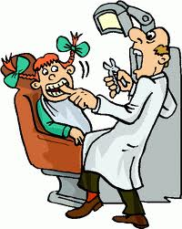
Making an Appointment with the Dentist
Dentist Office Assistant: Good morning, Beautiful Smile Dentistry, this is Jamie. How may I help you today?
Patient: Good morning, I'd like to schedule a check-up.
Dentist Office Assistant: I'd be happy to do that for you. Have you been to Beautiful Smile before?
Patient: Yes, I have. My last check-up was six months ago.
Dentist Office Assistant: Great. Can I get your name, please?
Patient: Yes, of course, sorry. My name is Ron Appleman.
Dentist Office Assistant: Thank you Mr. Appleman. Which dentist did you
see on your last check-up?
Patient: I'm not sure, really.
Dentist Office Assistant: That's OK. Let me check your chart... Oh, Dr. Lee.
Patient: Yes, that's right.
Dentist Office Assistant: OK... Dr. Lee has time next Friday in the morning.
Patient: Hmmm... that's not good. I've got work. How about the week after that?
Dentist Office Assistant: Yes, Dr. Lee has some times open. Would you like to suggest a time?
Patient: Does he have anything open in the afternoon?
Dentist Office Assistant: Yes, we could fit you in on Thursday, January 14th at 2.30 in the afternoon.
Patient: Great. That'll work.
Dentist Office Assistant: OK, thank you for calling Mr. Appleman, we'll see you next week.
Patient: Thank you, bye bye.
Dentist Office Assistant: Goodbye.

Slide 8
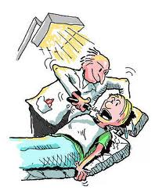
Going to the dentist really unnerves me!
Jake has a terrible toothache, but he refuses to see a dentist because he had an unnerving experience before:
Jake:
Ouch! This tooth is really bugging me.
Anna:
Maybe you have a cavity. Have you seen the dentist?
Jake:
No, I haven't. Going to the dentist really unnerves me. I try to avoid it like the plague.
Anna:
Come on. Don't be a chicken! It can't be that bad!
Jake:
I'm not a chicken! But I'll do anything to keep myself from getting in the dentist's chair.
Anna:
Even deal with a tooth that's killing you?
Jake:
You bet.

Slide 9
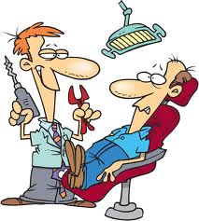
I went to the dentist to get a check- up and cleaning. I showed up at the dentist's office a few minutes before 10. I gave the receptionist my name and told her that I had a 10 a.m. appointment. She said that the doctor was running a little late and that I should take a seat. After about 15 minutes, a dental assistant came out and told me to follow her. She led me to a room and told me to take a seat in the exam chair, and then she put a dental bib on me.
The dentist came into the room.
Dentist: Hello, how are you today? Here for your six month check-up?
Gary: I'm fine, Dr. Meecham. Yes, just a cleaning and check- up today.
Dentist: Oh, fine. Let's take a look.
She probed my teeth and checked my gums.
Dentist: Well, it looks like you have a cavity and your crown is loose. We need to fill that cavity before it gets any worse and the crown needs to be refitted. Make an appointment for next week and I'll take care of them.
Gary: Okay, I'll do that, but my crown was just put on last year. Will my dental insurance cover the work?
Dentist: Since you had that done here, we'll take care of it. There won't be a charge. And, your insurance should cover the work on the cavity. Now, I'm going to have the hygienist do your cleaning and I'll see you soon for the other work.
Gary: Thanks, doctor.
The hygenist came into the room and had me rinse with mouthwash. She began her cleaning and finished by polishing my teeth. On my way out, I tried to make an appointment for the following week. Unfortunately, there were no appointments available for two weeks, and the time they had was an inconvenient one, but I said I'd manage. I have to say, going to the dentist can be a pain, in the mouth and in the butt.

Slide 10
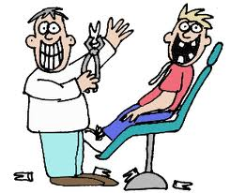
Dentist: Well, it looks like you have a cavity and your crown is loose. We need to fill that cavity before it gets any worse and the crown needs to be refitted. Make an appointment for next week and I'll take care of them.
Gary: Okay, I'll do that, but my crown was just put on last year. Will my dental insurance cover the work?
Dentist: Since you had that done here, we'll take care of it. There won't be a charge. And, your insurance should cover the work on the cavity. Now, I'm going to have the hygienist do your cleaning and I'll see you soon for the other work.
Gary: Thanks, doctor.
The hygenist came into the room and had me rinse with mouthwash. She began her cleaning and finished by polishing my teeth. On my way out, I tried to make an appointment for the following week. Unfortunately, there were no appointments available for two weeks, and the time they had was an inconvenient one, but I said I'd manage. I have to say, going to the dentist can be a pain, in the mouth and in the butt.

Slide 11
Dialogue at the Dentist
I went in for a dental visit the other day, a scheduled filling for my lower cavity & I was supposed to go back for the upper, since he didnt want to do both at the same time and leave me paralyzed in the face and mouth, thanks doc, much appreciated. I have always had good teeth so the occasional cavity is like so horrible to think about. "Doc", I say, "I hate hate hate the Novocaine, and the last time it hurt so much. It left me half paralyzed I looked and felt scary, my husband couldnt look at me when I laughed".
"Well...he says, we can try the gas..."
"YES! Do it!"
"Well you will still feel the sensation..."
"TRY it!" I demand.
As he begins to explain how I will feel altered, I interrupt him to tell him i have done recreational drugs so I am ready...
and the nose peace goes on...ahhhh,
"concentrate on your breathhhhhhhh"
"Um, I dont think its working" (waw waw waw waw i begin to hear in my head...for those of you who have done nitrous balloons before:)
"So, how are your kids doing?" he asks
"PAAAH!!!" I start cracking up!
"Well, it must be working... Marylin, maybe we should turn it down..."
"NO, PLEASE!" ( I beg)" this is the highlight of my day, crank it up! It even makes the drill sound funny..."

Slide 12
"Ok, concentrate on your breathing, in thru the nose..."
"Doc, this isn‘t Lamaze" says the hygienist...
"Right," he mutters, "and here wont don‘t say the "P" word..."
Time out I signal - "do you mean pussy, or pain?"
LOL LOL - "Oh no, we say pussy here! Just not pain! and where did you get that from?"
Hygienist says- "well we did mention Lamaze!"
"Oh yea..." so he proceeds to drill and fill etc. - and I suck in thru my nose as hard as I can to get as much gas as I can while I have it hooked up right to my NOSE! Could life be any better at this moment?
"Ok, am just about done here..."
"WAIT! Doc, can you PLEASE just fill the top one to while I am here-" (I beg)
"well....um.. ok he agrees after looking at my chart and almost not doing it..
(ANYTHING to keep the high going, what a nitrous crackhead!!)
So he prepares me for the top drilling giving me a chance to suck in a lil more gas!
OMG I am in heaven now...
I keep my eyes closed, lay there, and continue to float in nitrous heaven. Hells, I think I am gonna start eating now and laters before bed and not brushing my teeth just to get back in there!!!
Word to the wise, NEVER get Novocaine, but if you must then INSIST on the GAS!! You will LOVE going to the dentist! Trust me! You will LOVE it:)

Slide 13
Dental Hygiene
Sam: Hello.
Gina the Dental Hygienist: Hello Mr. Waters. I'm Gina. I'll be cleaning your teeth today.
Sam: Dr. Peterson has just filled two cavities. Why do I need a cleaning?
Gina the Dental Hygienist: Well, we have to make get your teeth and gums clean and disease free.
Sam: I guess that makes sense.
Gina the Dental Hygienist: Oral health leads to trouble-free teeth. I'll start off by removing plaque. Please lean back and open wide.
Sam: OK, I hope it's not too bad.
Gina the Dental Hygienist: Everybody gets plaque, even if they floss regularly. That's why it's important to come in twice a year for check-ups.
Sam: (getting his teeth cleaned, can't say much...)
Gina the Dental Hygienist: OK, please take a drink and rinse.
Sam: Ah, that's better.
Gina the Dental Hygienist: OK, now I'll apply some fluoride. Which flavor would you like?
Sam: I have a choice?
Gina the Dental Hygienist: Sure, we have mint, spearmint, orange or bubble-gum - that's for the kids.
Sam: I'd like to have the bubble-gum!
Gina the Dental Hygienist: OK. (applies fluoride) Now, let me give your teeth a final flossing.
Sam: What type of floss tape do you recommend?
Gina the Dental Hygienist: Personally, I like the flat tape. It's easier to get between the teeth.
Sam: OK, I'll remember that the next time I buy floss. How often should I floss?
Gina the Dental Hygienist: Everyday! Twice a day if possible! Some people like to floss after every meal, but that's not absolutely necessary.
Sam: (after finishing the cleaning) I feel much better. Thank you.
Gina the Dental Hygienist: My pleasure. Have a pleasant day, and remember to floss every day - at least once a day!

Slide 14
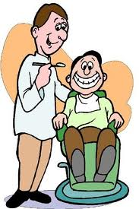
VOCABULARY:
to clean someone's teeth
dental hygienist
to fill cavities
gums
disease free
oral health
to lead to
plaque
to remove plaque
to floss
check-up
to rinse
fluoride
to apply fluoride
flavor
flossing
floss tape
floss after meals

Slide 15
Dr. Chung: Hello, Luis, I’m Dr. Chung. You’re here for a check-up and a cleaning, is that right?
Luis: Yes, that’s right.
Dr. Chung: Okay, let’s take a look. Have you had your wisdom teeth taken out?
Luis: No, I haven’t.
Dr. Chung: Hmm…You may need to do that soon. You’ve had a root canal?
Luis: Yes, about three years ago.
Dr. Chung: Does that hurt?
Luis: Ow!
Dr. Chung: I guess I hit a nerve. The bad news is that you may need another root canal soon. Let’s see if you have any cavities. Oh, I think there’s one here in your left molar. You’ll need to come back for a filling. Are you experiencing any sensitivity?
Luis: Yes, I am!
Dr. Chung: I’m not surprised. Your gums have receded and some of the root is showing. Do you use dental floss?
Luis: Um, yes.
Dr. Chung: I’ll have the dental hygienist show you how to brush and floss better so you can prevent the buildup of plaque and tartar. Any questions for me before the hygienist starts on your cleaning?
Luis: No, I’m just glad you didn’t say I need dentures!
Dr. Chung: No, you don’t. Not yet.

Slide 16
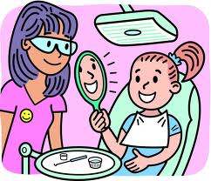
VOCABULARY:
cavities
no offense taken
nothing against
stunk
When it rains it pours
max
capped out
root canal
wisdom teeth
out of pocket
Read the introduction:
Everybody has to go to the dentist sometime. If you’re lucky, you won’t have any cavities. You can just get your teeth cleaned once or twice a year.
Many people are afraid of the dentist. Even a regular cleaning can be uncomfortable, even painful.
Dental care can be expensive too. But in the States, if you have dental insurance, you may not have to pay much for dental services.
Listen to Amanda and Kevin talk about the dentist.

Slide 17
Kevin: I think the only thing I like having done at the dentist is when I go and get my teeth cleaned.
Amanda: Are you being serious?
Kevin: Yes.
Amanda: I think getting your teeth cleaned is more painful that having actual work done.
Kevin: I think you need a new dentist.
Amanda: Well, maybe. See, my dad is my dentist.
Kevin: Oh! Sorry.
Amanda: He’s just retired, though, so no, no offense taken.
Kevin: Ok. Ok.
Amanda: But…
Kevin: I’m sure he’s a really good dentist, nothing against your father.
Amanda: No problem. Have you noticed that you can go years and have no problems whatsoever, and then a six-month span will come and boom, all your teeth go basically to crap.
Kevin: Unbelievable. When it rains it pours. Yes.
Amanda: And you know, your insurance coverage, it… you have a max.
Kevin: Yes.
Amanda: You have three, four services done, you’re capped out.
Kevin: And that’s it.
Amanda: Then you’re out of luck. You need a root canal, you need your wisdom teeth taken out, you’re paying out of pocket. And it’s not like you can wait till the next year for your insurance to come back in.
Kevin: ‘Cause it hurts. Like, when you have, like, a serious tooth problem, you can’t wait for that. I mean it’s… I… Once when I was in college, I was eating a piece of pizza and two halves of two teeth fell out. And I went then to the dentist at the university and he said that my childhood dentist loved metal so he filled my cavity…
Amanda: Amalgam. Kevin: So now I have two crowns…
Kevin: …too much. Amanda: And they don’t even use that anymore.
Amanda: Yes. Kevin: Yeah. It really stunk.

Slide 18
Discussion
Amanda and Kevin disagree about what is more painful: a cleaning or other dental work.
When Amanda says she thinks a cleaning is more painful, Kevin says she needs a new dentist. Oops! He doesn’t realize that Amanda’s dad is her dentist. He apologizes for the comment, but Amanda is not offended.
Amanda’s father is retired. That means he doesn’t work anymore because he is of a certain age. In the US, most people retire from working around the age of 65.
Amanda says that you can sometimes experience many dental problems at once. She says, “all your teeth go basically to crap.”
“Going to crap” is a slang expression that means something has degenerated or the quality is not as good as it was. This is a very casual expression, not appropriate for all situations.
Multiple dental problems can become expensive because most dental insurance policies only pay for a limited amount.
Kevin had to have two crowns put in because his former dentist overfilled his cavities. Crowns are artificial extensions used on broken or rotten teeth.
Are you afraid of the dentist?
Is dental care expensive where you live?

Slide 19
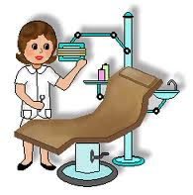
ZDROJE:
U zubaře. SpeakEnglish! [online]. 2012 [cit. 2012-06-24]. Dostupné z: http://www.speakenglish.co.uk/phrases/at_the_dentists
English for Medical Purposes - Dental Hygiene. About.com [online]. 2012 [cit. 2012-06-24]. Dostupné z: http://esl.about.com/od/englishformedicalpurpose/a/d_dhyg.htm
Places in the Community-1. Esldivlabs.vcc.ca [online]. 2012 [cit. 2012-06-24]. Dostupné z: http://esldivlabs.vcc.ca/ELSA/Instructor_Web_Exercises/Vocabulary/Places_in_the_Community_1_Multiple_Choice.htm
Going to the Dentist in Japan. AccessJ [online]. 2012 [cit. 2012-06-24]. Dostupné z: http://www.accessj.com/2011/11/going-to-dentist-in-japan.html

