Slide 1

NÁZEV ŠKOLY: ZŠ Dolní Benešov, přísp.organizace
AUTOR: Mgr. Marta Rozsívalová
TEMA: Beatles – slovní zásoba
ČÍSLO PROJEKTU: CZ 1.07/1.4.00/211262
NÁZEV: VY_32_INOVACE_02_ Angličtina 9.ročník

Slide 2
Anotace
Žáci doplňují vynechaná slova v textu na základě poslechu, píší je do připravených listů

Slide 3
Beatles
Yesterday

Slide 4

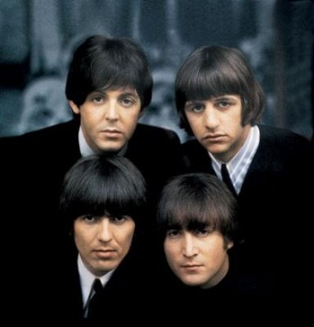
Song
Yesterday, all my 1……………….. seemed so far away
Now it 2…………… … as though they're here to stay
Oh, I 3 …………………yesterday.
Suddenly, I'm not half to man I used to be,
There's a shadow hanging over me.
Oh, yesterday 4……………….. suddenly.
Why she 5…………...... I don't know she wouldn't say.
I 6……………………. something wrong, now I long for yesterday.
Yesterday, love was such an easy 7………………………..to play.
Now I need a place to hide away.
Oh, I believe in yesterday.
Why she had to go I don't know she wouldn't say.
I said something wrong, now I long for yesterday.
Yesterday, love was such an easy game to play.
Now I 8…………….a place to hide away.
Oh, I believe in yesterday.

Slide 5
Song
Yesterday, all my troubles seemed so far away
Now it looks as though they're here to stay
Oh, I believe in yesterday.
Suddenly, I'm not half to man I used to be,
There's a shadow hanging over me.
Oh, yesterday came suddenly.
Why she had to go I don't know she wouldn't say.
I said something wrong, now I long for yesterday.
Yesterday, love was such an easy game to play.
Now I need a place to hide away.
Oh, I believe in yesterday.
Why she had to go I don't know she wouldn't say.
I said something wrong, now I long for yesterday.
Yesterday, love was such an easy game to play.
Now I need a place to hide away.
Oh, I believe in yesterday.

Slide 6
Citace:
Http://www.mp3stahuj.cz/7141/the-beatles-yesterday [online]. 2011 [cit. 2011-09-07]. Let it be,mp3 ke stažení. Dostupné z WWW: <http://www.mp3stahuj.cz/7141/the-beatles-yesterday>.
Http://img.karaoketexty.cz/img/artists/124/the-beatles-25019.jpg [online]. 2011 [cit. 2011-09-07]. The-beatles-25019.jpg. Dostupné z WWW: <http://img.karaoketexty.cz/img/artists/124/the-beatles-25019.jpg>.
2011-02-09
Text je vytvořen autorem materiálu
2011-02-09

