Slide 1


Obchodní akademie a Jazyková škola
s právem státní jazykové zkoušky Jihlava
Šablona 32
VY_32_INOVACE_ 126.ANJ.34
Over the map of Great Britain

Slide 2
Číslo projektu: CZ.1.07/1.5.00/34.0744
Šablona: EU peníze školám SŠ / šablona III/2
Číslo DUMU: 126.ANJ.34
Název materiálu: Over the map of Great Britain
Autor: Mgr. Tomáš Bojanovský
Předmět: Anglický jazyk
Formát: Prezentace Microsoft Powerpoint
Velikost: 3.35 MB
Stupeň a typ vzdělávání: SŠ – odborné vzdělávání
Licence k obrazovému materiálu: CC-BY-SA, Public Domain
Datum vytvoření : 1.12.2012
Klíčová slova: Angličtina, obrázek, Velká Británie
Anotace : Výstup slouží k výkladu problematiky reálií Velké Británie. Vhodné pro maturitní otázky v profilové školní části ústní zkoušky.

Slide 3

England ???
Write the official name of the country!

Slide 4
The United Kingdom of Great Britain and Northern Ireland

Slide 5
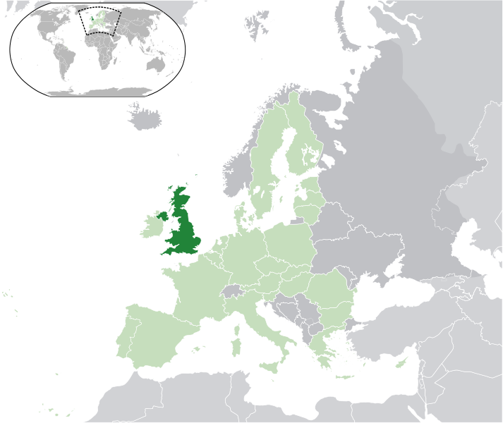
The United Kingdom of Great Britain and Northern Ireland
Island country
Separated by
British Channel
Autor: NuclearVacuum, licence Creative Commons, BY-SA
http://en.wikipedia.org/w/index.php?title=File:EU-United_Kingdom.svg&page=1

Slide 6
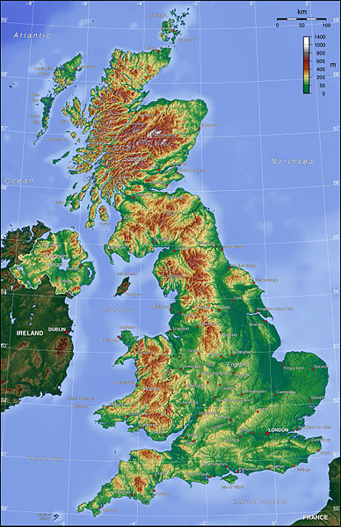
The United Kingdom of Great Britain and Northern Ireland
Neighbours
Autor: Captain Blood, licence Creative Commons, BY-SA
http://en.wikipedia.org/wiki/File:Uk_topo_en.jpg

Slide 7
The United Kingdom of Great Britain and Northern Ireland
4 parts
Autor: Captain Blood, licence Creative Commons, BY-SA
http://en.wikipedia.org/wiki/File:Uk_topo_en.jpg

Slide 8
The United Kingdom of Great Britain and Northern Ireland
4 parts:
England
Wales
Scotland
Nothern Ireland
borders
Autor: Captain Blood, licence Creative Commons, BY-SA
http://en.wikipedia.org/wiki/File:Uk_topo_en.jpg

Slide 9
The United Kingdom of Great Britain and Northern Ireland
Capital cities:
England
Wales
Scotland
Nothern Ireland
Autor: Captain Blood, licence Creative Commons, BY-SA
http://en.wikipedia.org/wiki/File:Uk_topo_en.jpg

Slide 10
The United Kingdom of Great Britain and Northern Ireland
Capital cities:
England
London
Wales
Cardiff
Scotland
Edinburgh
Nothern Ireland
Belfast
Autor: Captain Blood, licence Creative Commons, BY-SA
http://en.wikipedia.org/wiki/File:Uk_topo_en.jpg

Slide 11
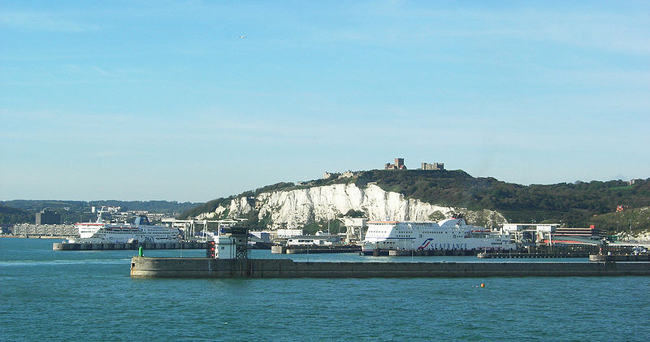
The United Kingdom of Great Britain and Northern Ireland
Dover
cliffs
Autor: Remi Jouan, licence Creative Commons, BY-SA
http://en.wikipedia.org/wiki/File:Douvres_(4).JPG
Autor: Captain Blood, licence Creative Commons, BY-SA
http://en.wikipedia.org/wiki/File:Uk_topo_en.jpg

Slide 12
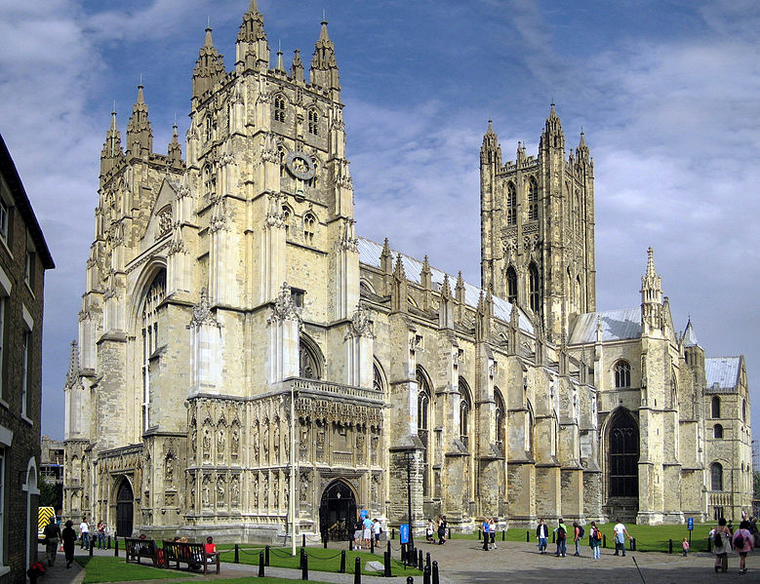
The United Kingdom of Great Britain and Northern Ireland
Other cities:
Canterbury
seat of Archbishop
Autor: Hans Musil, licence Creative Commons, BY-SA
http://en.wikipedia.org/wiki/File:Canterbury_Cathedral_-_Portal_Nave_Cross-spire.jpeg
Autor: Captain Blood, licence Creative Commons, BY-SA
http://en.wikipedia.org/wiki/File:Uk_topo_en.jpg

Slide 13
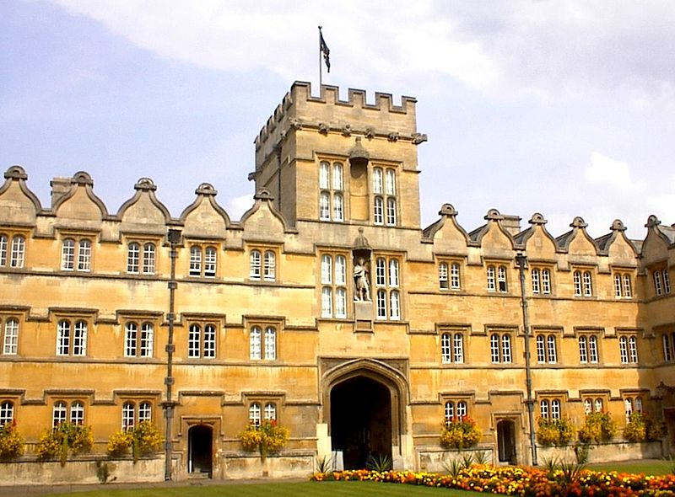
The United Kingdom of Great Britain and Northern Ireland
Other cities:
Oxford, Cambridge
http://en.wikipedia.org/wiki/File:University_College_Oxford.jpg
Autor: Captain Blood, licence Creative Commons, BY-SA
http://en.wikipedia.org/wiki/File:Uk_topo_en.jpg

Slide 14
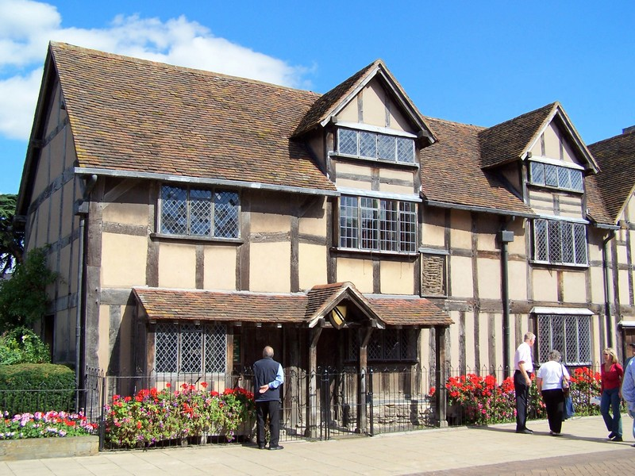
The United Kingdom of Great Britain and Northern Ireland
Other cities:
Stratford upon Avon
Autor: Kev747, licence Creative Commons, BY-SA
http://en.wikipedia.org/wiki/File:William_Shakespeare_-birthplace_-house2.jpg
Autor: Captain Blood, licence Creative Commons, BY-SA
http://en.wikipedia.org/wiki/File:Uk_topo_en.jpg

Slide 15
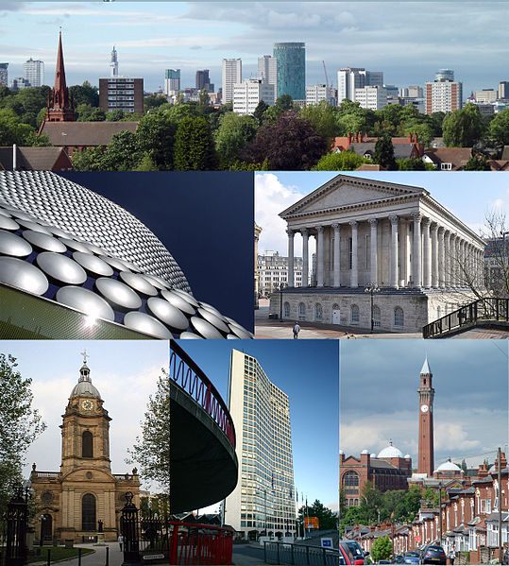
The United Kingdom of Great Britain and Northern Ireland
Other cities:
Birmingham
Autor: JimmyGuano, licence Creative Commons, BY-SA
http://en.wikipedia.org/wiki/File:Birmingham_Montage_2012.jpg
Autor: Captain Blood, licence Creative Commons, BY-SA
http://en.wikipedia.org/wiki/File:Uk_topo_en.jpg

Slide 16
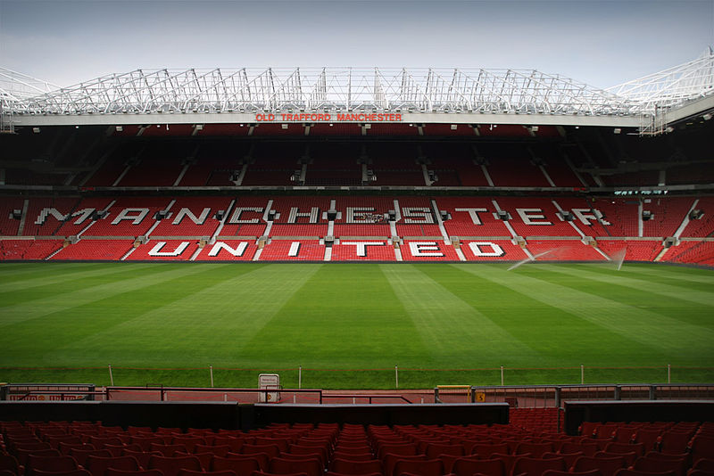
The United Kingdom of Great Britain and Northern Ireland
Other cities:
Manchester, Leeds, Sheffield
Autor: André Zahn, licence Creative Commons, BY-SA
http://en.wikipedia.org/wiki/File:Old_Trafford_inside_20060726_1.jpg
Autor: Captain Blood, licence Creative Commons, BY-SA
http://en.wikipedia.org/wiki/File:Uk_topo_en.jpg

Slide 17
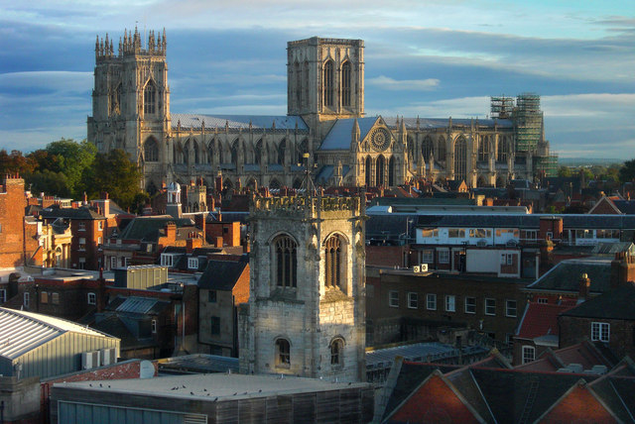
The United Kingdom of Great Britain and Northern Ireland
Other cities:
York
Autor: Peter McDermott, licence Creative Commons, BY-SA
http://en.wikipedia.org/wiki/File:York_Minster_-_geograph.org.uk_-_1549780.jpg
Autor: Captain Blood, licence Creative Commons, BY-SA
http://en.wikipedia.org/wiki/File:Uk_topo_en.jpg

Slide 18
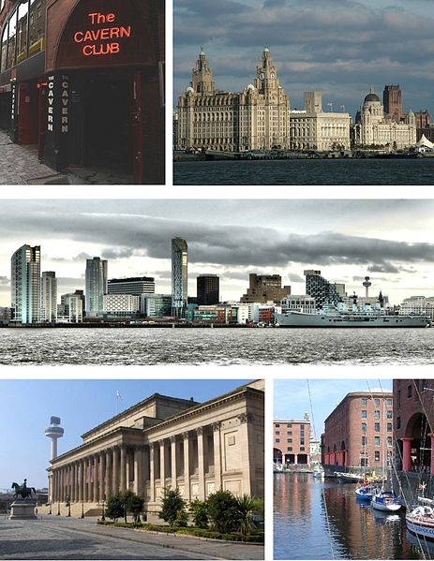
The United Kingdom of Great Britain and Northern Ireland
Other cities:
Liverpool
Autor: Daviessimo, licence Creative Commons, BY-SA
http://en.wikipedia.org/wiki/File:Liverpool_Montage.jpg
Autor: Captain Blood, licence Creative Commons, BY-SA
http://en.wikipedia.org/wiki/File:Uk_topo_en.jpg

Slide 19
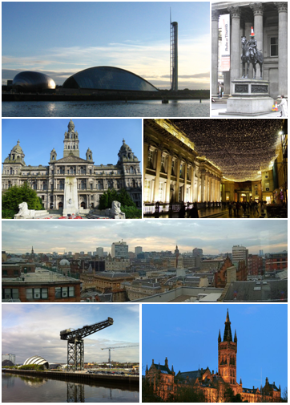
The United Kingdom of Great Britain and Northern Ireland
Other cities:
Glasgow
Autor: Scottfree92, licence Creative Commons, BY-SA
http://en.wikipedia.org/wiki/File:Glasgow_Montage.png
Autor: Captain Blood, licence Creative Commons, BY-SA
http://en.wikipedia.org/wiki/File:Uk_topo_en.jpg

Slide 20
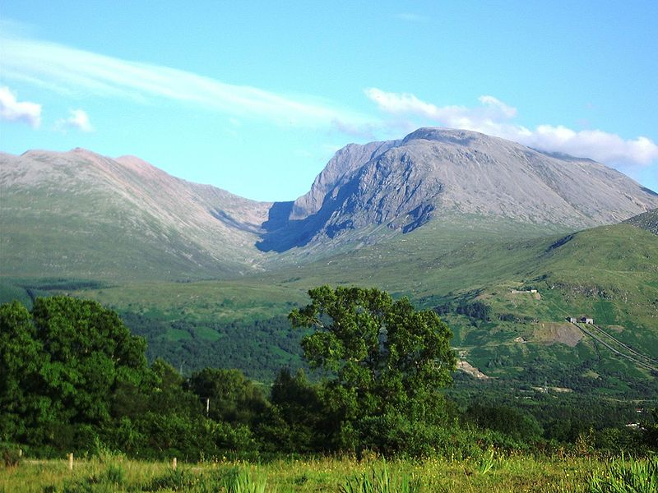
The United Kingdom of Great Britain and Northern Ireland
Mountains:
Ben Nevis 1343 m
http://en.wikipedia.org/wiki/File:BenNevis2005.jpg
Autor: Captain Blood, licence Creative Commons, BY-SA
http://en.wikipedia.org/wiki/File:Uk_topo_en.jpg

Slide 21
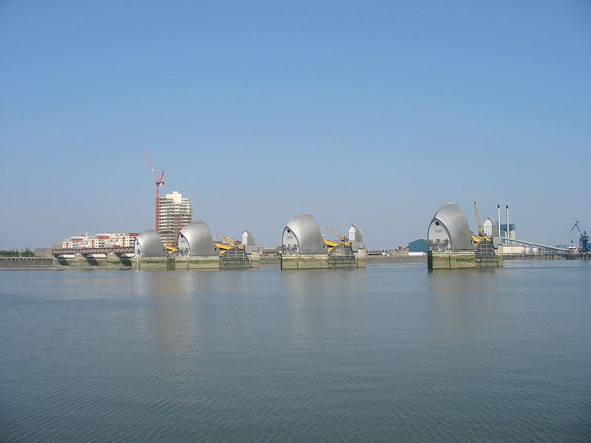
The United Kingdom of Great Britain and Northern Ireland
Rivers:
The Thames, The Severn
Autor: Tom Corser, licence Creative Commons, BY-SA
http://en.wikipedia.org/wiki/File:Thames_Barrier_London.jpg
Autor: Captain Blood, licence Creative Commons, BY-SA
http://en.wikipedia.org/wiki/File:Uk_topo_en.jpg

Slide 22
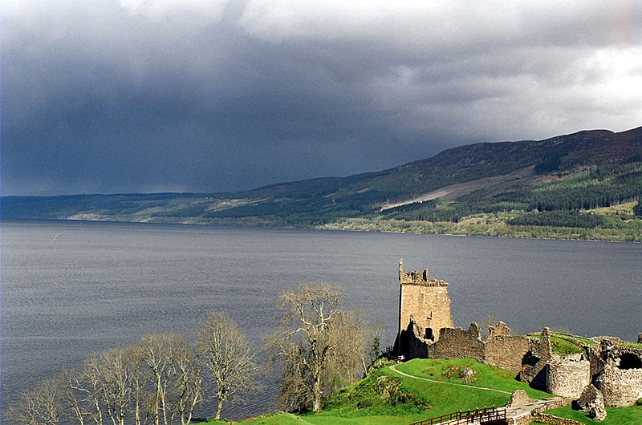
The United Kingdom of Great Britain and Northern Ireland
Lakes:
Loch Ness, Loch Lomond
Autor: Captain Blood, licence Creative Commons, BY-SA
http://en.wikipedia.org/wiki/File:Uk_topo_en.jpg
Autor: Sam Fentress, licence Creative Commons, BY-SA
http://en.wikipedia.org/wiki/File:LochNessUrquhart.jpg

Slide 23
Všechny uveřejněné odkazy dostupné pod licencí Creative Commons (autoři uvedeni pod obrázky).
Obrázek str. 13, 20 dostupný pod licencí Public domain.
Materiály jsou určeny pro bezplatné používání pro potřeby výuky a vzdělávání na všech typech škol a školských zařízeních. Jakékoliv další využití podléhá autorskému zákonu.

