Slide 1
ENVIRONMENTAL PROBLEMS
Mgr. Naďa Bisová

Slide 2
Anotace
Kód DUMu: VY_32_INOVACE_6.AJ.11
Číslo projektu: CZ.1.07/1.5.00/34.0114
Vytvořeno: září – říjen 2012
Ročník: 3. ročník a 4. ročník – čtyřleté gymnázium (RVP-G)
Septima a Oktáva – osmileté gymnázium (RVP-G)
Anotace:
Tento materiál by vytvořen jako téma pro maturitní okruh: Science and Technology. Nature na Gymnáziu a JŠ Svitavy; přibližně na jednu, popřípadě více vyučovacích hodin (pro výklad i opakování – shrnutí učiva). Obsahuje jednak přehled faktografických údajů, tak i anglickou ustálenou terminologii, doplněné o interaktivní cvičení: otázky pro diskuzi a míru porozumění, fotografie pro nácvik popisu obrázku a videa pro poslech s porozuměním. Je primárně zaměřen na dva poslední ročníky gymnázia, i přesto se dá využít i v nižších ročnících osmiletého i čtyřletého studia vcelku nebo jeho jednotlivé části.
Pomůcky: interaktivní tabule
Vzdělávací oblast | Jazyk a jazyková komunikace
Vzdělávací obor | Anglický jazyk
Tematický okruh | Science and Technology. Nature

Slide 3
GLOBAL ENVIRONMENTAL ISSUES
Water pollution
Soil / land pollution + littering
Air pollution
Noise pollution
Natural habitat destruction (rainforests, coral reefs)
Animal and plant protection
Energy sources

Slide 4
WATER POLLUTION
=
introduction of harmful materials
into a body of water
Pure drinking water has already become a problem in many parts of the world.

Slide 5
WATER POLLUTION
comes from:
harmful industrial processes
households
pesticides and other chemicals (e.g. fertilizers) used in agriculture
waste disposal sites
from ships (oil and chemical spills)
acid rain
etc.

Slide 6
WATER POLLUTION
Recommendation
saving water (wasting: from our baths, gardens, repair leaking pipes, etc.)
reducing the amount of chemicals
developing environmentally-friendly pesticides
changing farming practices
banning pouring factory chemicals into lakes and rivers
banning washing / cleaning cars by the river
controls and fines
etc.

Slide 7
SOIL / LAND POLLUTION
=
introduction of harmful materials into
the surface environment

Slide 8
SOIL / LAND POLLUTION
comes from:
industrial waste
domestic rubbish in landfills
litter, dust and rubbish in the streets
radioactive substances
detergents, chemical pesticides and fertilizers
etc.

Slide 9
SOIL / LAND POLLUTION
Recommendation
reducing the volume of landfill
re-using and recycling
avoiding wasting food and materials
choosing products that have less packaging
composting kitchen garbage and garden waste of organic origin (fertilizers, biogas)
introducing fines
placing strict controls over the storage, use and disposal
preferring environmentally-friendly products to plastic products (PVC,…)
turning contaminated land sites into parks
etc.

Slide 10
AIR POLLUTION
=
harmful chemicals in the atmosphere
AP consists of chemicals or particles in the air
that can harm
the health of humans, animals and plants. It also damages buildings.

Slide 11
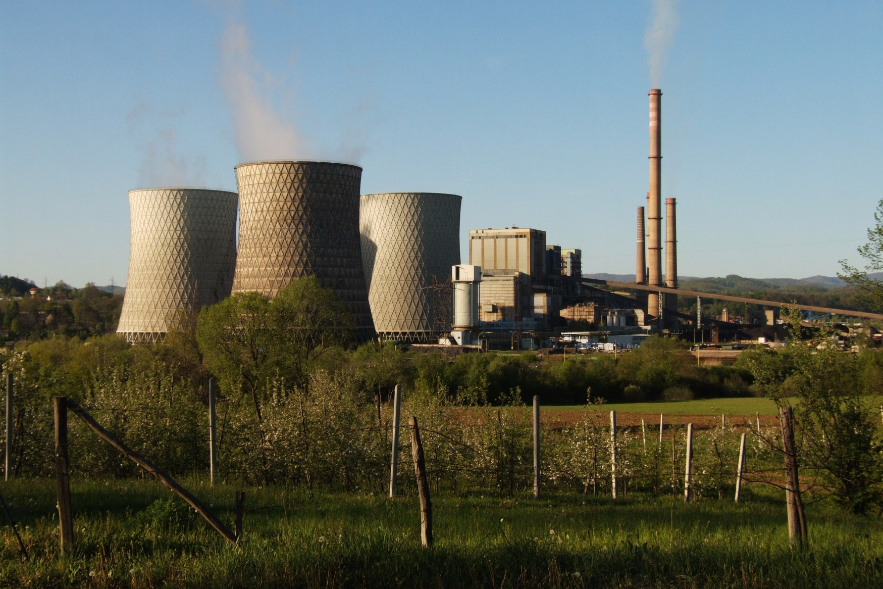
AIR POLLUTION
1.

Slide 12
AIR POLLUTION
comes from:
a) Natural sources:
smoke from wildfires
ash from volcanoes
dust
b) Man-made sources:
emissions from factories, cars, planes
emissions from aerosol cans containing CFCs
cigarette smoke
etc.

Slide 13
AIR POLLUTION
Recommendation
using alternative sources of energy (solar, water, wind, geothermal, steam, etc.)
burning smokeless fuel
using cars less, walking and biking instead
supporting public transportation
building cycle paths and lanes
using unleaded petrol
petrol-driven cars fitted with catalytic converters
planting new trees in gardens, parks and along the roads
rainforest protection
strict controls and fines
etc.

Slide 14
AIR POLLUTION
SMOG
combination of the words: smoke and fog
made up of a lot of pollutants and greenhouse gasses
reduces visibility
high levels of smog → itchy eyes, sore throat and nose, heavy breathing
the main component of smog = ozone
Video: BBC News

Slide 15
AIR POLLUTION
ACID RAIN
rain that has been made acidic
high levels of nitric and sulfuric acids
in the form of: snow, fog or tiny bits of dry material that settle on Earth
falls on buildings, cars, trees and plants
can cause health problems
most acid rain falls because of human activities
burning fossil fuels → sulfur dioxide (SO2) and nitrogen oxides (NOx) released into the atmosphere → react with water, oxygen and other substances → form sulfuric and nitric acid

Slide 16
AIR POLLUTION
ACID RAIN
acid rain spread by winds
enters water systems and sink into the soil
makes waters acidic / toxic → to crayfish, clams, fish and other aquatic animals → the food chain → impacts birds, etc.
damages forests (leaves and needles harmed) → not able to withstand cold temperatures, insects and disease
to fight acid rain = fewer fossil fuels
individuals → less electricity → fewer chemicals by power plant emissions
Video: National Geographic

Slide 17
AIR POLLUTION
THE OZONE LAYER
the atmosphere made up of several layers
one layer (many km high) called ozone (a form of oxygen, naturally produced)
important layer
surrounds the Earth like a protective blanket
absorbs many of the sun´s harmful ultraviolet (UV) rays
too many UV rays → more sunburn → skin cancer , + eye damage
too many UV rays → plankton killed (the base of the food chain in oceans/seas) → whales + other fishes dying out
too many UV rays → green plants damaged → fewer plants on Earth, less food
Video: National Geographic

Slide 18
AIR POLLUTION
THE OZONE HOLE
a hole in the ozone layer (e.g. over Antarctica in the South Pole, first discovered in 1985)
the ozone layer getting thinner all over the planet
holes thanks to man-made chemicals (ODS – ozone depleting substances: e.g. CFCs – Chloro-Fluoro-Carbons)
CFCs used in some spray cans, refrigerators, air-condition systems, etc.
sun cream and sunglasses important
Video: National Geographic

Slide 19
AIR POLLUTION
GREENHOUSE EFFECT
heat from the sun warms the earth → then escapes back into space (normally)
carbon dioxide + other gasses trap the sun´s heat → cannot escape back into space → the atmosphere gets too hot → the earth warmer
factories, electricity plants and cars
Video: National Geographic
Animated Video: BBC News
Another sources: ENVIS (Environmental Information System)

Slide 20
AIR POLLUTION
GLOBAL WARMING
a gradual increase in world temperatures of air and water
the planet is heating up
this time probably caused by polluting gasses (e.g. Carbon dioxide from cars and factories)
deforestation adds to the problem
if the earth keeps getting warmer → the sea level might rise, animals may become extinct, more floods and storms
Video: National Geographic

Slide 21
NOISE POLLUTION
results in stress, lack of concentration and irritation, defective hearing, hearing loss or sleeplessness
threatens animals
from motor vehicles and aircraft or in a work environment
loud music through headphones /MP3 players → hurting ears
regulations and strict controls
fines

Slide 22
NATURAL HABITAT DESTRUCTION
many endangered animal and plant species
are dying out
comes from:
deforestation
coral reefs in danger
soil/ land pollution
acid rain
wild fires
etc.

Slide 23
NATURAL HABITAT DESTRUCTION
Recommendation
establishing “green belts” around major cities
establishing national parks and nature reserves
saving the rainforests
protecting natural habitats (e.g. forests, rivers, streams, meadows, …)
increasing public awareness (how to behave in a forest, prevention, setting rules)
controls and fines
etc.

Slide 24
RAINFORESTS
THEIR IMPORTANCE
home of many insects, plants, and animals
produce oxygen
absorb carbon dioxide
the roots keep water and soil in place
„lungs of our planet“

Slide 25
RAINFORESTS
in danger: making plantations to grow food
growing cash crops like rubber
turning land into cattle ranches
cutting down hardwoods
growing population need more land
getting mineral or metals out of the ground
etc.
Notes:
cutting down hardwoods (teak, mahogany, etc.)

Slide 26
CORAL REEFS
in clear, tropical oceans
need sunlight to survive + temperature above 18 degrees Celsius
three types: fringing r., barrier r., atolls
corals: white, red, pink, green, blue, orange and purple
plants that live on the reef give food and provide shelter for reef animals (e.g. Lobsters)
largest reef in the world: The Great Barrier Reef in Australia (1900 km)
„rainforests of the sea“
Video: BBC News
Notes:
in clear, tropical oceans (the Caribbean, the Indo-Pacific ocean)

Slide 27
CORAL REEFS
Coral ecosystem importance
absorb carbon dioxide
produce oxygen
provide food and shelter
a big source of diversity
protect land from harsh weather (strong waves, storms)
a useful educational tool
a huge tourist attraction
provide jobs through fishing and tourism
provide a good source of medicine against of variety of illnesses
etc.

Slide 28
CORAL REEFS
face numerous hazards and threats
natural events
pollution
overfishing
tourist activities
leaking fuels, oil spills, petroleum spills
mining them with explosives, chopping them down for jewellery
etc..
Notes:
natural events (hurricanes, cyclones, disease, prolonged exposure to cold and rainy weather)
pollution (costal development activities, agricultural and deforestation activities, sewage)
overfishing (reef fishes collected for food, fishing methods)
tourist activities (careless divers and tourists)

Slide 29
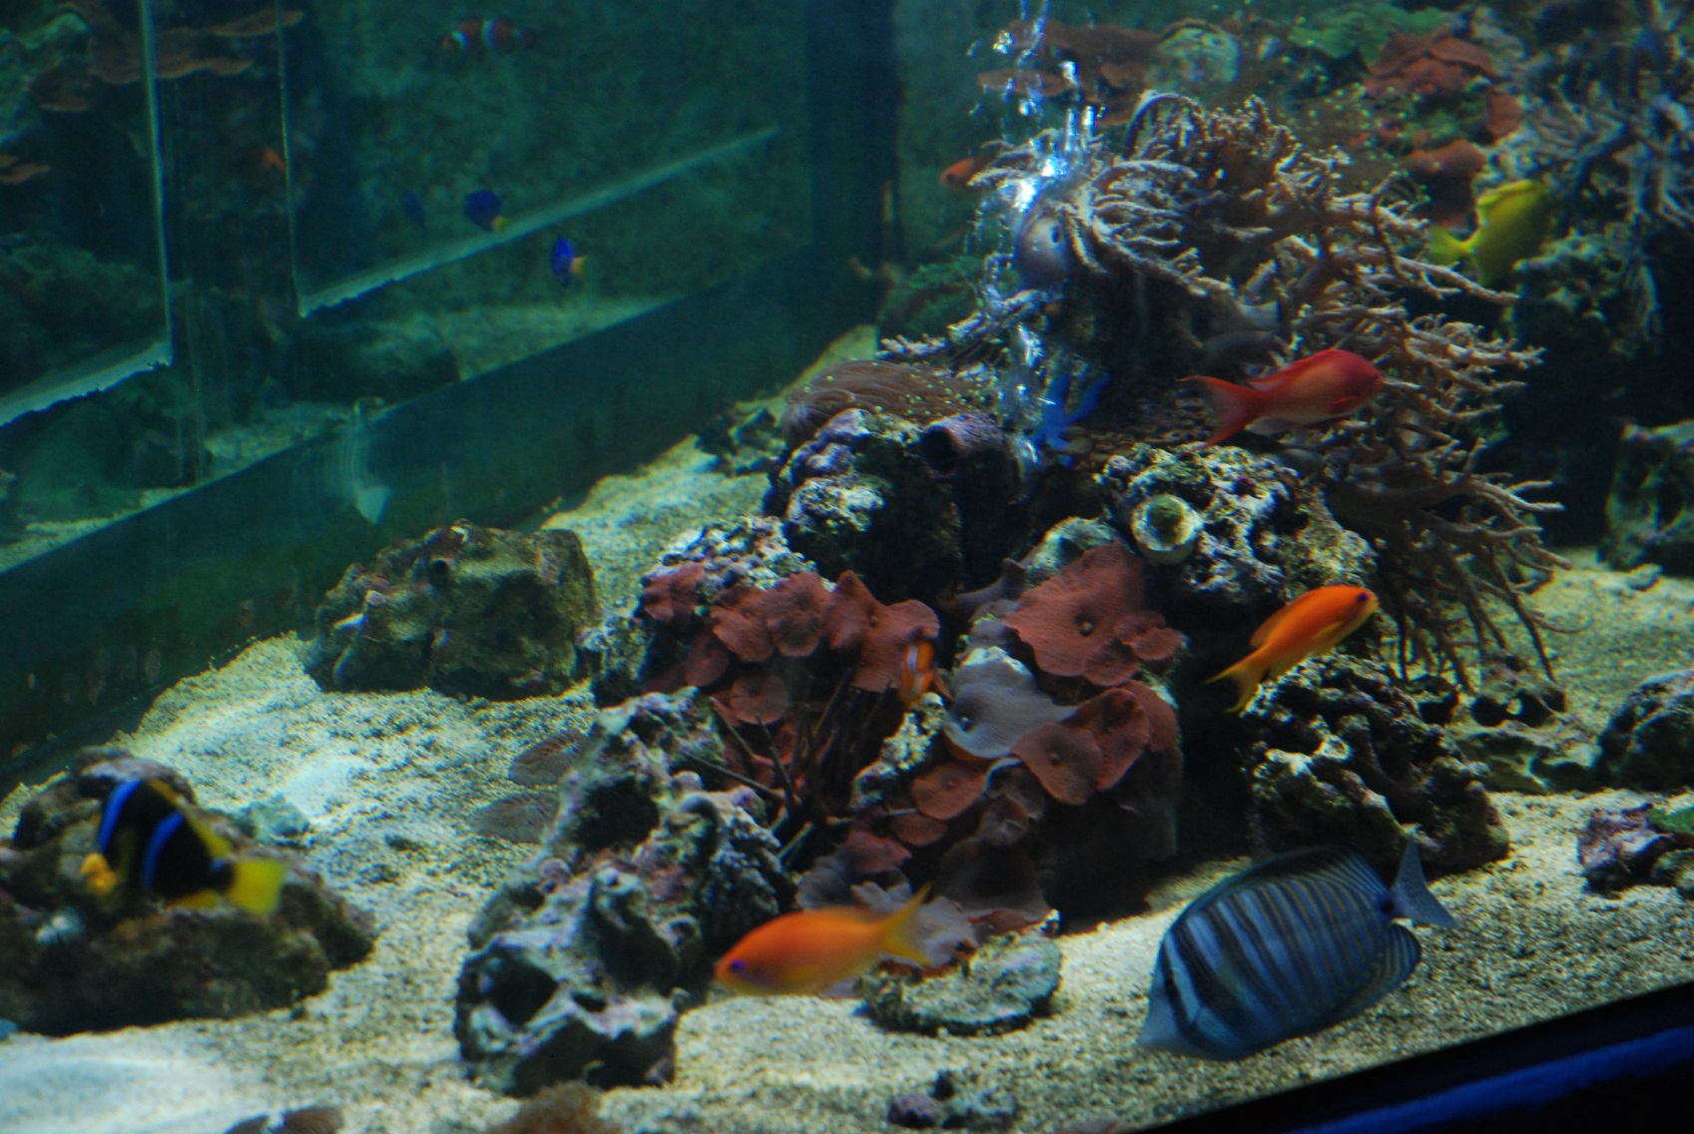
CORAL REEFS
2.

Slide 30
ANIMAL AND PLANT PROTECTION
extinct / rare species (hunting, poachers, over-fishing, natural habitat destruction,…)
thanks to human activities
some animals protected
others bred in captivity for release in the wild
national parks and nature reserves established
ZOOs built and improved
Etc.

Slide 31
ENERGY SOURCES
Most of the energy we use today comes from coal, oil and gas.
Recommendation
limit or stop burning fossil fuels (e.g. coal)
look for and use alternative / renewable sources of energy
use energy coming from methane from landfills waste sites
save the amount of electricity in households
using compact fluorescent light bulbs (CFLs)
etc.
Video: National Geographic

Slide 32
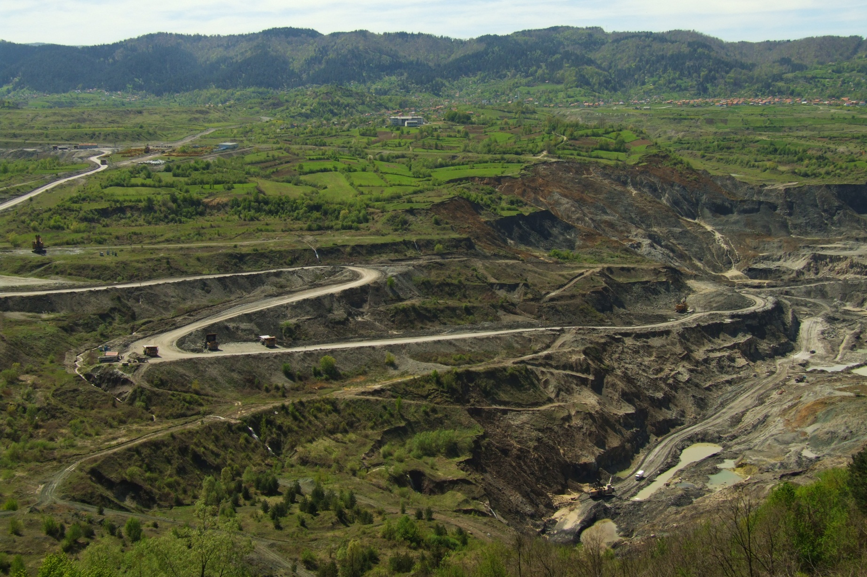
3.

Slide 33
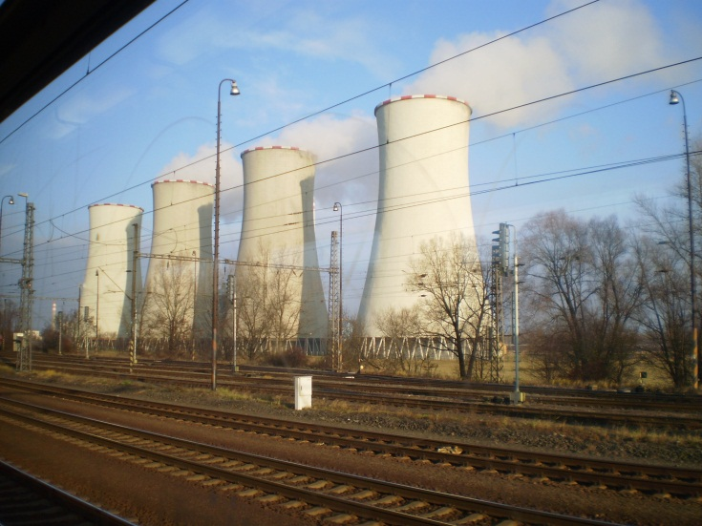
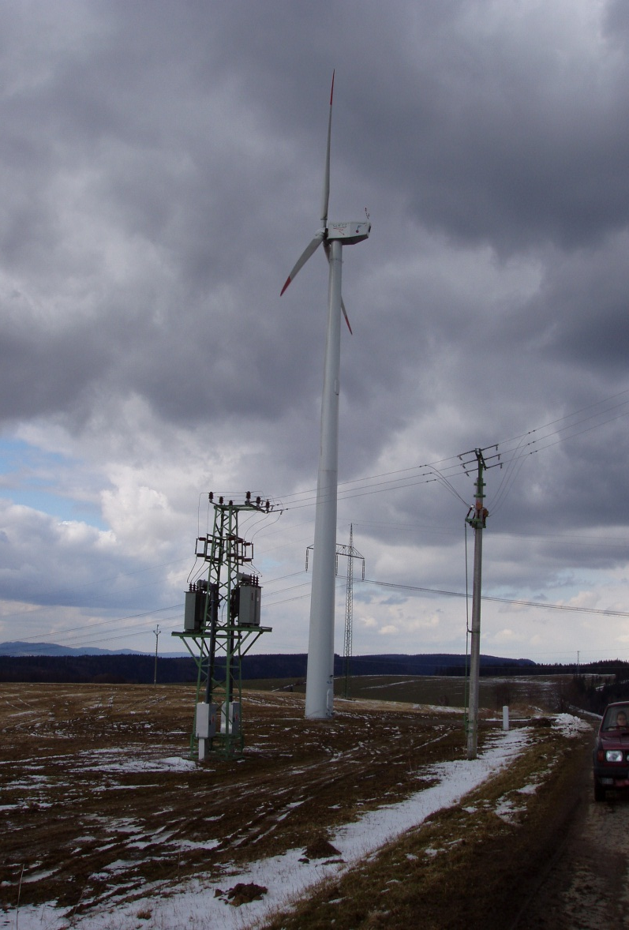
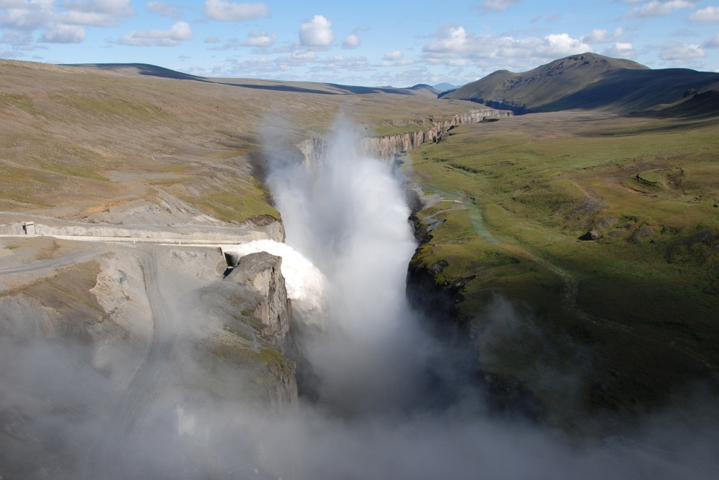
ENERGY SOURCES – compare and contrast the pictures
5.
4.
6.

Slide 34
Comprehension task
Use the following photos to talk about the problems of the environment.

Slide 35
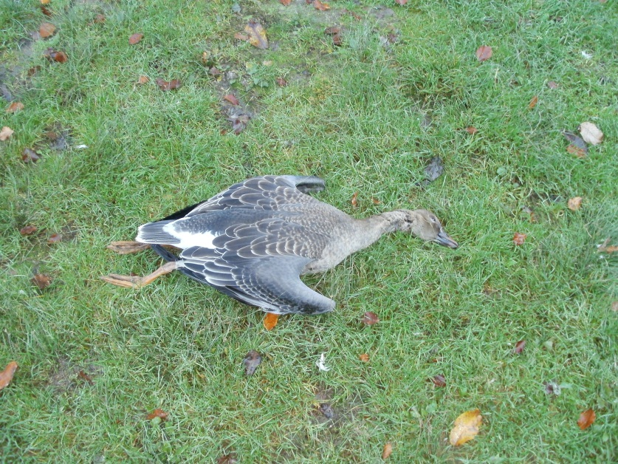
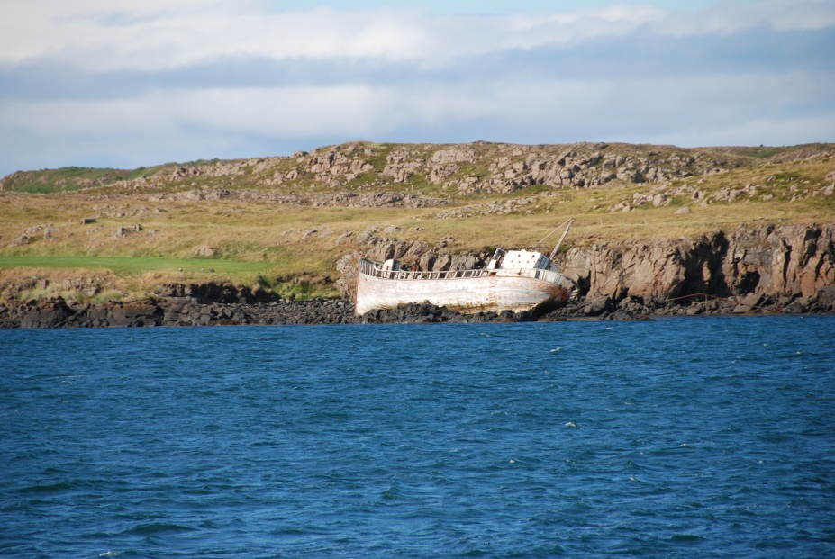
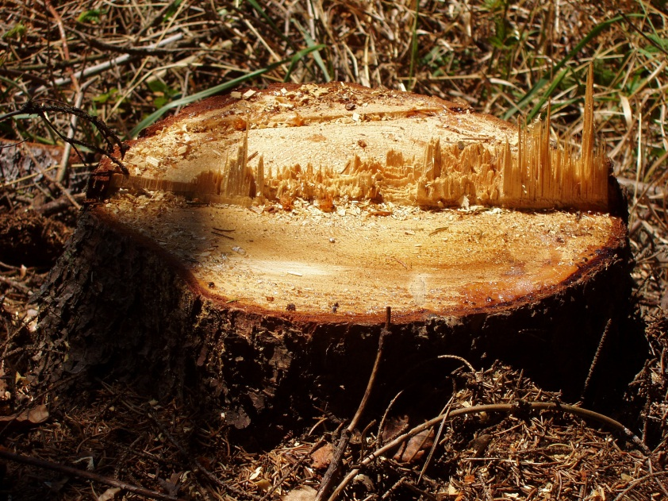
7.
9-.
8.

Slide 36
Comprehension questions
Are you aware of any global environmental issues?
How are people destroying our planet?
What is global warming?
What is the Greenhouse Effect? What is it caused by?
What is the ozone layer and what is its function?
What can you say about acid rain?
What do you know about deforestation and coral reefs?
Do you know any alternative sources of energy?

Slide 37
Zdroje a použitá literatura
FOTOGALERIE:
Fučík Artur (Se souhlasem autora objektu)
Kovářová (Se souhlasem autora objektu)
Fučík Artur (Se souhlasem autora objektu)
Tomčíková Naděžda (Se souhlasem autora objektu)
Tomčíková Naděžda (Se souhlasem autora objektu)
Brousková Ivana (Se souhlasem autora objektu)
Bisová Naďa (Vlastní tvorba autora)
Bisová Naďa (Vlastní tvorba autora)
Brousková Ivana (Se souhlasem autora objektu)

Slide 38
Zdroje a použitá literatura
KNIŽNÍ ZDROJE:
1. SMITH-DLUHÁ, Gabrielle a kol. Angličtina, Otázky a odpovědi. Dubicko: INFOA, 2008, ISBN 978-80-7240-489-6.
2. ROBERTS, Rachel J.. Speak Up - The English-speaking World. Italy: Modern Languages, 2006, ISBN 88-493-0439.
3. TIERNEY, James. Carousel - the English-speaking world. Italy: Modern languages, 2006, ISBN 88-493-0355.
4. EL-HMOUDOVÁ, Dagmar. Angličtina - Maturitní témata. Český Těšín: Petra Velanová, Třebíč, 2006, ISBN 9788086873046.
5. CHUDÁ, Jana; CHUDÝ, Tomáš. Topics for English Conversation. Havlíčkův Brod: Fragment, 1996, ISBN 8072000519.

Slide 39
Zdroje a použitá literatura
ELEKTRONICKÉ ZDROJE:
AUTOR NEUVEDEN. Ontario: Ministry of the Environment: Kids: Things you can do for the air we breathe [online]. [cit. 22.10.2012]. Dostupný na WWW: <http://www.airqualityontario.com/science/kids.php>.
AUTOR NEUVEDEN. National Geographic: Air Pollution [online]. [cit. 22.10.2012]. Dostupný na WWW: <http://environment.nationalgeographic.com/environment/global-warming/pollution-overview>.
AUTOR NEUVEDEN. EPA: What is acid rain? [online]. [cit. 3.10.2012]. Dostupný na WWW: <http://www.epa.gov/acidrain/education/site_students/whatisacid.html>.
AUTOR NEUVEDEN. National Geographic: Kids: Record-Breaking Year for Ozone Hole [online]. [cit. 3.10.2012]. Dostupný na WWW: <http://kids.nationalgeographic.com/kids/stories/spacescience/ozone/>.

Slide 40
Zdroje a použitá literatura
AUTOR NEUVEDEN. BBC NEWS: Greenhouse effect [online]. [cit. 3.10.2012]. Dostupný na WWW: <http://news.bbc.co.uk/2/shared/spl/hi/sci_nat/04/climate_change/html/greenhouse.stm>.
AUTOR NEUVEDEN. BBC NEWS: Global Warming [online]. [cit. 3.10.2012]. Dostupný na WWW: <http://news.bbc.co.uk/cbbcnews/hi/find_out/guides/world/global_warming/newsid_1575000/1575441.stm> .
AUTOR NEUVEDEN. NREL: Renewable Energy Basics [online]. [cit. 3.10.2012]. Dostupný na WWW: <http://www.nrel.gov/learning/re_basics.html>.
AUTOR NEUVEDEN. BBC Nature Wildlife: Rainforest [online]. [cit. 3.10.2012]. Dostupný na WWW: <http://www.bbc.co.uk/nature/habitats/Tropical_and_subtropical_moist_broadleaf_forests>.

Slide 41
Zdroje a použitá literatura
BLACK, Richard. BBC NEWS: Coral reefs heading for fishing and climate crisis [online]. [cit. 22.10.2012]. Dostupný na WWW: <http://www.bbc.co.uk/news/science-environment-12530439>.
Veškeré hypertextové odkazy jsou platné ke dni vytvoření díla.

