Slide 1
Školní potřeby
- obrázkové čtení se spojkou A
SŠ, ZŠ a MŠ, Karviná, příspěvková organizace
Mgr. Jana Karkošková

Slide 2



Slide 3
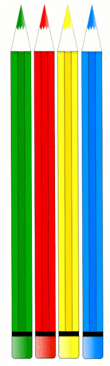

A

Slide 4
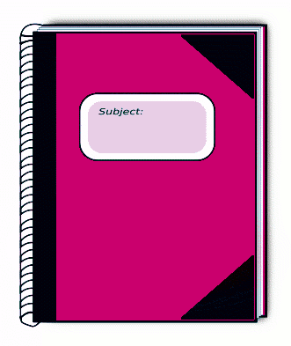

A

Slide 5


A

Slide 6

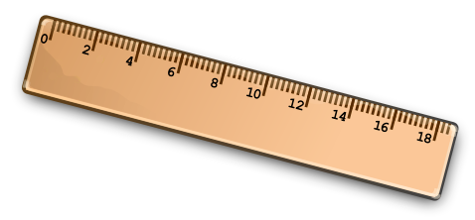
A

Slide 7

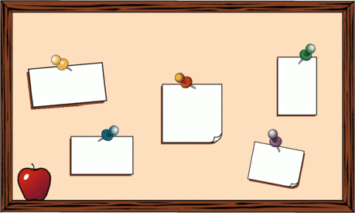
A

Slide 8


A

Slide 9

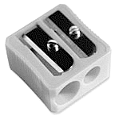
A

Slide 10

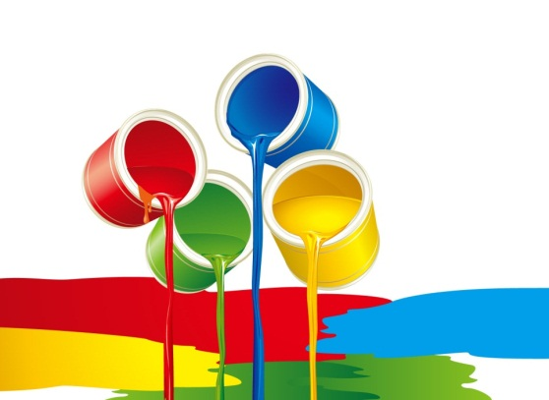
A

Slide 11



Slide 12
Použité zdroje: http://www.pdclipart.org/albums/Education/normal_colored_pencils.png - pastelky http://www.clipartpal.com/_thumbs/pd/education/ruler_copper_colored.png - pravítko http://www.clipartpal.com/_thumbs/pd/education/backpack_01.png - školní batoh http://www.clipartpal.com/_thumbs/pd/education/pencil_sharpener.png - ořezávátko http://www.clipartpal.com/_thumbs/pd/education/stappler.png - sešívačka http://www.pdclipart.org/albums/Education/normal_eraser.png - guma http://www.pdclipart.org/albums/Education/normal_school_bullitin_board.png - nástěnka http://www.clipartpal.com/_thumbs/pd/education/pencil_large.png - tužka http://www.clipartdb.com/data/media/15/blackboard.gif - tabule http://www.clipartpal.com/_thumbs/pd/education/scissors.png - nůžky http://picasaweb.google.com/lh/photo/usIGCX01OIOtXUVmed0uWQ - lepidlo http://www.pdclipart.org/albums/Education/books-aj.svg_aj_ashton_01.png - knihy http://www.pdclipart.org/albums/Education/normal_brush.png - štětec http://www.pdclipart.org/albums/Education/subject_book_pink.png - sešit http://wallpaperpassion.com/download-wallpaper/8133/illustration-of-colorful-paints-wallpaper.html - barvy http://openclipart.org/people/Anonymous/Anonymous_pen_pencil_3.svg - pero http://www.clipartpal.com/clipart_pd/education/crayon1.html http://openclipart.org/people/Merlin2525/1295991433.svg - hvězda

