Slide 1
Název školy: Základní škola Městec Králové
Autor: Mgr. Marcela Kloučková
Název: VY_32_INOVACE_10_Aj6
Číslo projektu: CZ.1.07/1.4.00/21.2313
Téma: Minulý čas – sloveso být
Anotace: Prezentace sloužící k procvičení slovesa být
v minulém čase.
Datum: 4. 7. 2012

Slide 2
Past Simple of TO BE
(minulý čas prostý slovesa být)

Slide 3
Affirmative
(kladné oznamovací věty)
I was
we were
you were
you were
they were
he
she
it
was

Slide 4
Negative (zápor)
I was not (wasn‘t)
you were not (weren‘t)
he
she was not (wasn‘t)
it
we were not (weren‘t)
you were not (weren‘t)
they were not (weren‘t)

Slide 5
Questions (otázky)
Was I?
Were you?
he?
Was she?
it?
Were we?
Were you?
Were they?

Slide 6
Short answers (krátké dpovědi)
Yes, I/he/she/it was.
Yes, you/we/they were.
No, I/he/she/it wasn‘t.
No, you/we/they weren‘t.

Slide 7
Translate.
1. I was on holiday in Germany last year.
Minulý rok jsem byl na dovolené v Německu.
2. They were at school yesterday.
Včera byli ve škole.
3. He wasn‘t ill last week.
Minulý týden nebyl nemocný.
4. We weren‘t at the cinema on Friday.
V pátek jsme nebyli v kině.
5. Were you at home on Monday afternoon?
Byl jsi / byli jste doma v pondělí odpoledne?
6. Where were you yesterday?
Kde jsi byl / jste byli včera?

Slide 8
Complete the sentences. Use was, were, wasn‘t and weren‘t.
1. Were you at the swimming pool yesterday?
No, I wasn‘t . I was at a football match.
2. Was Jane at school last week? Yes, she was.
3. Why were you at home last week? We were ill.
4. Were they at the cinema yesterday? No, they weren‘t. They were at the theatre.
5. When was Peter on holiday? He was on holiday last summer.
6. Were they in London? Yes, they were in London last year.
7. Were you at John‘s party last night? Yes, I was.
It was great.

Slide 9
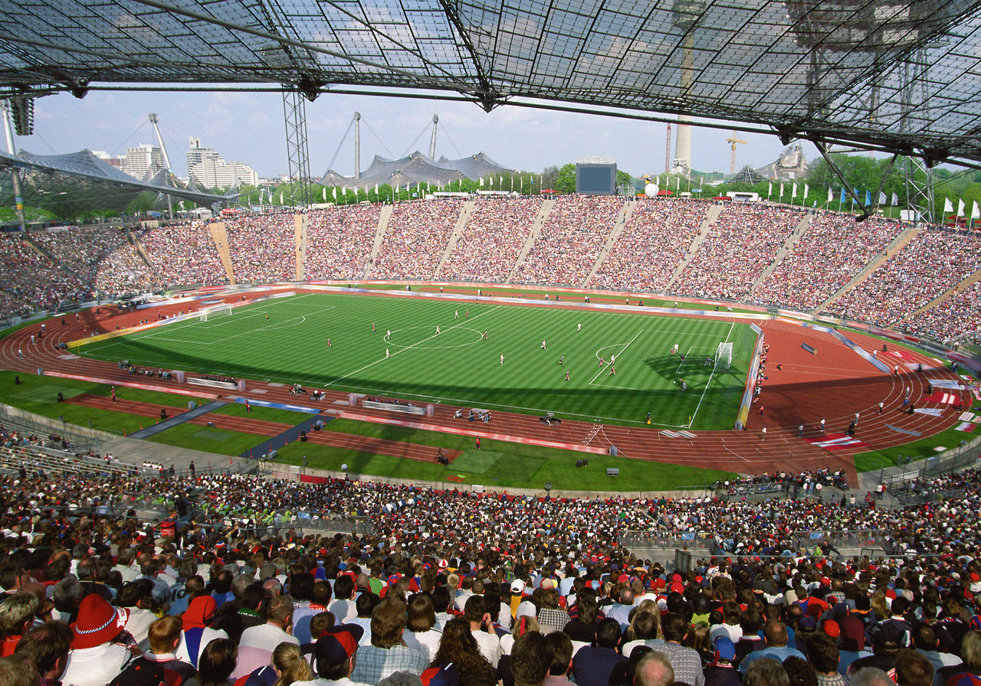
Where were Peter and Tom?
football match
They were at a football match.
[1]

Slide 10

Where was he?
theatre
He was at the theatre.
[2]

Slide 11

Where was Jane?
school
She was at school.
[3]

Slide 12
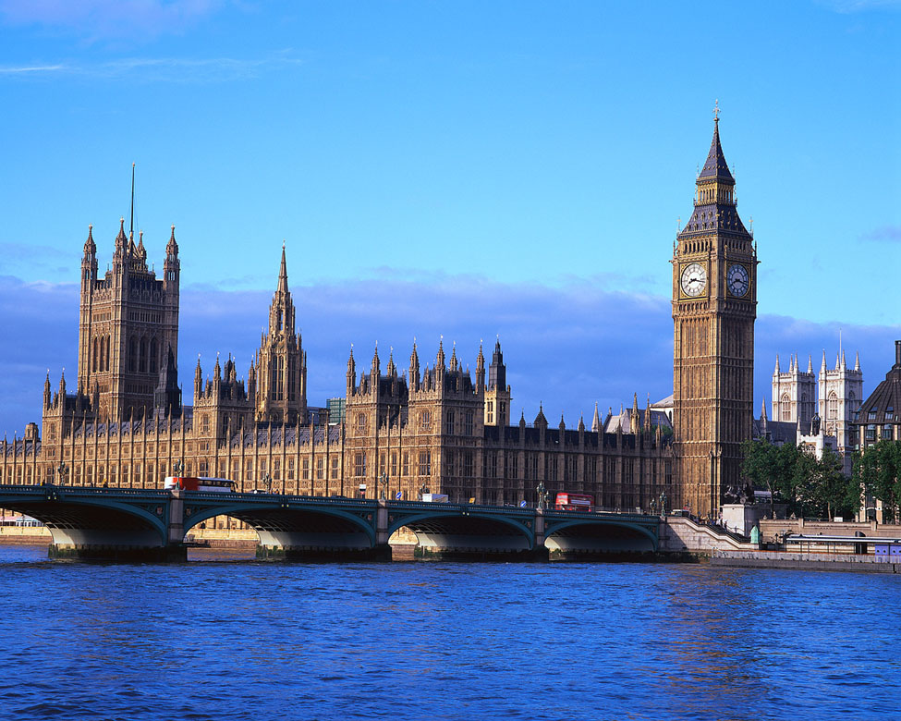
Where were they?
London
They were in London.
[4]

Slide 13
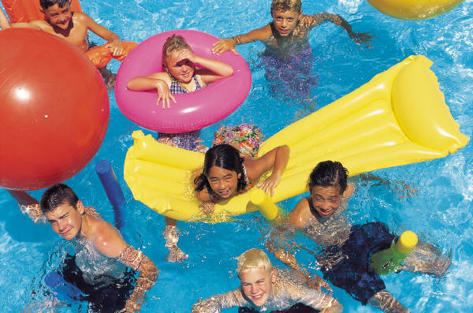
Where were you?
swimming pool
We were at the swimming pool.
[5]

Slide 14
Translate.
1. Byl Tom včera v kině? Ne, nebyl. Byl doma.
Was Tom at the cinema yesterday? No, he wasn‘t.
He was at home.
2. Byl jsi na dovolené ve Španělsku? Ano, byl jsem tam minulý rok.
Were you on holiday in Spain? Yes, I was there last year.
3. Včera jsme byli na školním výletě.
We were on a school trip yeasterday.
4. V pátek jsme nebyli ve škole.
We weren‘t at school on Friday.
5. Proč jsi byl minulý týden doma? Byl jsem nemocný.
Why were you at home last week? I was ill.

Slide 15
Zdroje
[1] Fotbal. Office.com [online]. 2012 [cit. 2012-12-04]. Dostupné z: http://office.microsoft.com/cs-cz/images/results.aspx?qu=fotbal&ex=2#ai:MP900422600|mt:2|
[2] Divadlo. Office.com [online]. 2012 [cit. 2012-12-04]. Dostupné z: http://office.microsoft.com/cs-cz/images/results.aspx?qu=divadlo&ex=1#ai:MP900442484|mt:2|
[3] Škola. Office.com [online]. 2012 [cit. 2012-12-04]. Dostupné z: http://office.microsoft.com/cs-cz/images/results.aspx?qu=%C5%A1kola&ex=1#ai:MP900438753|
[4] Londýn. Office.com [online]. 2012 [cit. 2012-12-04]. Dostupné z: http://office.microsoft.com/cs-cz/images/results.aspx?qu=Lond%C3%BDn&ex=2#ai:MP900407133|mt:2|
[5] Bazén. Office.com [online]. 2012 [cit. 2012-12-04]. Dostupné z: http://office.microsoft.com/cs-cz/images/results.aspx?qu=baz%C3%A9n&ex=1#ai:MP900227615|

