Slide 1

Tento materiál byl vytvořen rámci projektu EU peníze školám
Operačního programu Vzdělávání pro konkurenceschopnost
Název školy: |  | Základní škola a Mateřská škola, Hradec Králové, Úprkova 1
Autor: |  | Mgr. Medková Blanka
Název: |  | VY_32_INOVACE_4C_4_London (4)
Téma: |  | 4C_Aj 7.tř.
Datum ověření: |  | VM ověřen dne 4.10.2012 ve třídě 7. A, B
Číslo projektu: |  | CZ.1.07/1.4.00/21.3215
Anotace: |  | DUM je určen k rozvíjení schopnosti číst v cizím jazyce, což je velmi přínosné při učení jazyka – žáci se naučí nová slova, jejichž obsah odhadnou mnohdy i z kontextu, uvidí mnoho gramatických frází, struktur. Cílem tohoto DUMU je podpořit žáky ve schopnosti číst plynule autentický anglický text. Současně se seznámí s hlavním městem Velké Británie. Obrazový a zvukový materiál doplňuje žákům představu o probíraném námětu.

Slide 2
The Story Begins
There were people in the area near the River Thames a long time before the Roman Julius Caesar arrived in Britain in 55 BC.

Slide 3
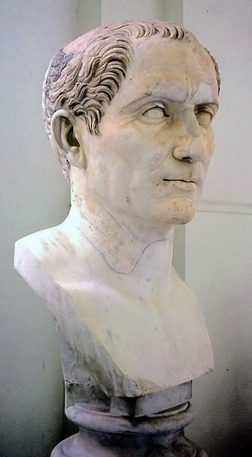
The Story Begins
Caesar and his men fought the people in the south of the country, and Caesar said the famous words „Veni, vidi, vici“ (I came,I saw, I won.)

Slide 4
The Story Begins
Some peoople think that Caesar built the first bridge across the river. The Romans came to Britain again eighty-eight years later.

Slide 5
The Story Begins
The River Thames was important to them, and they started to build a town there, north of the river. They gave it the name Londinium.

Slide 6
The Story Begins
The name „London“ comes from this Roman name. Fifteen years later, Londinium was a busy, important place.

Slide 7
The Story Begins
But there were problems. In 60 AD, the Romans started a fight with the wrong person. After her husband died, Boudica, a queen in the east of the country, was angry with the Romans.

Slide 8
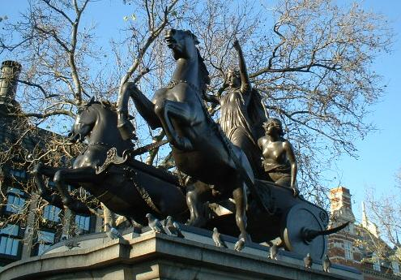

Slide 9
The Story Begins
She and her followers fought the Romans. They started a great fire and destroyed most of Londinium. But the Romans built the city again and it was bigger nad better.

Slide 10
The Story Begins
By the year 100 AD, London was capital of Roman Britain. A hundred years later, the Romans built thick city walls round Londinium.

Slide 11
The Story Begins
Between 20,000 and 50,000 people lived inside these walls. You can see some of the stones of the old Roman walls today.

Slide 12
The Story Begins
When the Romans left Britain in 410, the good times ended. But the Saxons came to Britain from area in Germany, and they started living near the river.

Slide 13
The Story Begins
In the early days, the Saxons did not use the old city, but in 834 Vikings from Scandinavia started to destroy other towns and cities.

Slide 14
The Story Begins
In 886, the Saxons king, Alfred, moved his people inside the old Roman city walls of Londinium.

Slide 15
London Bridge is Falling Down
London Bridge Is Falling Down - YouTube
Many British children sing this famous song, but not everybody knows the story.

Slide 16
London Bridge is Falling Down
When the Vikings took London in 1013, the English king, Aethelred, asked King Olaf of Norway for help. Olaf´s men pulled London Bridge down when the Vikings were on it. The bridge and Vikings fell into the river.

Slide 17
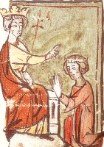
The Story Begins
In 1050 another king, Edward I., started building a great church, Westminster Abbey, west of the city.

Slide 18
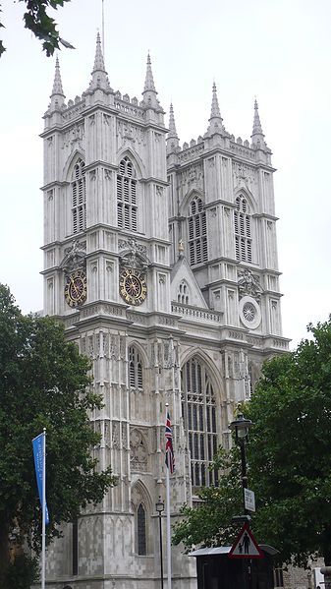
The Story Begins
The king built a palace, Westminster Palace, between the abbey and the river because he wanted to watch the builders. Workers finished the building in 1065, and Edward died days later.

Slide 19
The Story Begins
In 1066, a new king of England, William I. from France, stood in Westminster Abbey. William and his son, William Rufus, started to built fine new buildings in the city.

Slide 20
The Story Begins
The city was now about 1,000 years old. With its new centre in Westminster, it was ready for the next 1,000 years.

Slide 21
Tento materiál byl vytvořen rámci projektu EU peníze školám
Operačního programu Vzdělávání pro konkurenceschopnost
Použití zdroje: |  | SHIPTON, Vicky. London. Essex: Pearson Education Ltd, 2008, ISBN 978-1-4058-8164-7.
Citace: |  | WAHRA, Andreas. Wikipedia.cz [online]. [cit. 9.5.2013]. Dostupný na WWW: http://cs.wikipedia.org/wiki/Soubor:Giulio-cesare-enhanced_1-800x1450.jpg BRADY, A.. Wikipedia.cz [online]. [cit. 9.5.2013]. Dostupný na WWW: http://cs.wikipedia.org/wiki/Soubor:Boudiccastatue.jpg AUTOR NEUVEDEN. Wikipedia.cz [online]. [cit. 9.5.2013]. Dostupný na WWW: http://cs.wikipedia.org/wiki/Soubor:Edward_I_and_II.jpg OTAKAR, Přemysl. Wikipedia.cz [online]. [cit. 9.5.2013]. Dostupný na WWW: http://cs.wikipedia.org/wiki/Soubor:Westminster_cathedral.jpg AUTOR NEUVEDEN. Youtube.com [online]. [cit. 9.5.2013]. Dostupný na WWW: https://www.youtube.com/watch?v=7bmboogEivk
Anotace:

