Slide 1

Tento materiál byl vytvořen rámci projektu EU peníze školám
Operačního programu Vzdělávání pro konkurenceschopnost
Název školy: |  | Základní škola a Mateřská škola, Hradec Králové, Úprkova 1
Autor: |  | Mgr. Medková Blanka
Název: |  | VY_32_INOVACE_4C_5_London (5)
Téma: |  | 4C_Aj 7.tř.
Datum ověření: |  | VM ověřen dne 8.10.2012 ve třídě 7. A, B
Číslo projektu: |  | CZ.1.07/1.4.00/21.3215
Anotace: |  | DUM je určen k rozvíjení schopnosti číst v cizím jazyce, což je velmi přínosné při učení jazyka – žáci se naučí nová slova, jejichž obsah odhadnou mnohdy i z kontextu, uvidí mnoho gramatických frází, struktur. Cílem tohoto DUMU je podpořit žáky ve schopnosti číst plynule autentický anglický text. Současně se seznámí s hlavním městem Velké Británie, konkrétně s oblastí divadel.

Slide 2
London Theatre
London is one of the theatre capitals of the world. Most of the big theatres are in the West End. There are more than fifty theatres in this area.

Slide 3
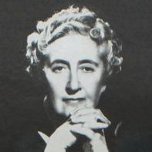
London Theatre
The Mousetrap, by Agatha Christie, started in the West End in 1952 and you can see the same play today!

Slide 4
London Theatre
A lot of the big plays in London now have songs and music in them. Some – The lion King, Mary Poppins and Billy Elliot – were films first.

Slide 5
London Theatre
One of the biggest names in London theatre is Andrew Lloyd Webber. He wrote the music for Cats and Evita.

Slide 6
London Theatre
In the 1500s, important people in the church did not like the theatre, so there were no theatres inside London´s city walls.

Slide 7
London Theatre
James Burbage built the first theatre, outside the walls, in 1576. Twenty-one years later, Peter Smith started building the Globe Theatre south the river, in Southwark.

Slide 8
London Theatre
This was the biggest theatre in London, and a lot of Londoners saw plays there. The first play at the Globe was about the Roman Julius Caesar.

Slide 9
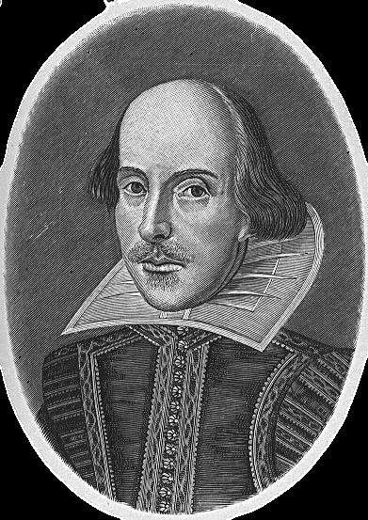
London Theatre
William Shakespeare (1564-1616) is Britain´s most famous writer. He lived in London for most of his life, and Londoners saw most of his thirty-seven plays at the Globe.

Slide 10
London Theatre - Boys and girls
In Shakespeare´s time, women could not be in plays. The people in the plays were all men. The film Shakespeare in Love was about this. Men played Juliet in Romeo an Juliet and Ophelia in Hamlet.

Slide 11
London Theatre
The first Globe Theatre closed in 1642, and builders destroyed in later. In the 1970s an American, Sam Wanamaker, wanted to build the theatre again.

Slide 12
London Theatre
After thirty years and o lot of money, the Globe is now in its old place in Southwark. You can see a Shakespeare play at the Globe!

Slide 13
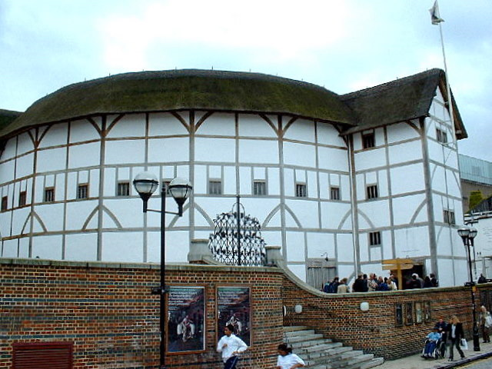

Slide 14
Tento materiál byl vytvořen rámci projektu EU peníze školám
Operačního programu Vzdělávání pro konkurenceschopnost
Použití zdroje: |  | SHIPTON, Vicky. London. Essex: Pearson Education Ltd, 2008, ISBN 978-1-4058-8164-7.
Citace: |  | REGGAE, Gary. Wikipedia.cz [online]. [cit. 9.5.2013]. Dostupný na WWW: http://cs.wikipedia.org/wiki/Soubor:Southwark_reconstructed_globe.jpg AUTOR NEUVEDEN. Wikipedia.cz [online]. [cit. 9.5.2013]. Dostupný na WWW: http://cs.wikipedia.org/wiki/Soubor:Agatha_Christie.png HELMOLT. Wikipedia.cz [online]. [cit. 9.5.2013]. Dostupný na WWW: http://cs.wikipedia.org/wiki/Soubor:Hw-shakespeare.png
Anotace:

