Slide 1

MY BODY

Slide 2
MY BODY
Základní škola Brno, Jana Babáka 1
Číslo materiálu: VY 32 INOVACE 06/17
Název materiálu: My Body
Číslo projektu: CZ.1.07/1.4.00/21.1486
Zpracoval: Mgr. Lada Novotná

Slide 3
Bibliografie
Bibliografie: : http://1.bp.blogspot.com/-107YXKeAXs/
UB6V49H9yuI/AAAAAAAACsY/69ceZJXaYZE/s1600/number-one-.png http://digimind.com/blog/wpcontent/
uploads/2012/02/number2c.png http://blog.scholarshippoints.com/wpcontent/
uploads/2010/11/number3.png http://blog.campaignasia.com/wpcontent/
uploads/2012/04/4NumberFourInCircle.png http://www.dirtyprettythangs.com/wpcontent/
uploads/2012/07/five.png http://coachdawnwrites.com/wp-content/uploads/2011/09/six.png
http://3.bp.blogspot.com/-rk4c3b-O0Zk/Txh8WXyxF8I/AAAAAAAADJE/6PbDF0ul_o8/s1600/seven.png
http://www.hickman.k12.ca.us/images/number%208.png
http://pixabay.com/static/uploads/photo/2012/04/01/18/28/outline-23897_640.png
http://www.stanprokopenko.com/blog/images/headanyangle/different-head-angles.jpg
http://farm5.static.flickr.com/4060/4383287546_d936a2ec2a_o.gif
http://bmarisol.files.wordpress.com/2010/03/knee1.jpg http://ecx.imagesamazon.
com/images/I/31O4uuZuMUL._SL500_AA300_.jpg
http://images.sodahead.com/polls/000222650/polls_arm_1_lg_3437_889795_answer_2_xlarge.gif
http://www.copestylin.com/images/hand.png http://www.clker.com/cliparts/T/0/D/U/h/6/leg-md.png
http://www.spraygraphic.com/storage/member_files/2424/picture/600_6bc3cc3236cd3ef80a49a20194c7e515.jpg

Slide 4
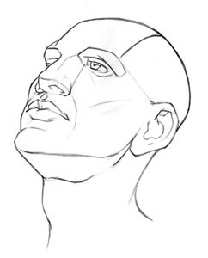
What’s this?

Slide 5
This is a head!

Slide 6
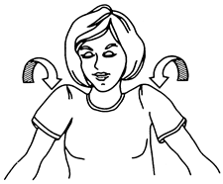
What’s this?

Slide 7
This is a shoulder!

Slide 8

What’s this?

Slide 9
This is a knee!

Slide 10
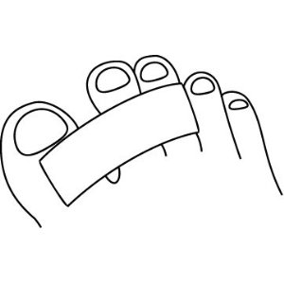
What is this?

Slide 11
This is a toe!

Slide 12
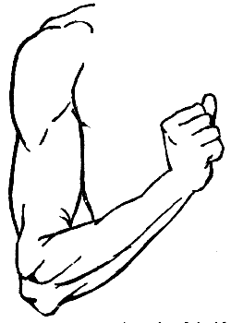
What’s this?

Slide 13
This is an arm!

Slide 14

What’s this?

Slide 15
This is a hand!

Slide 16
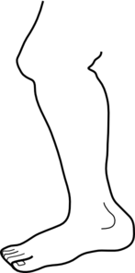
What’s this?

Slide 17
This is a leg!

Slide 18
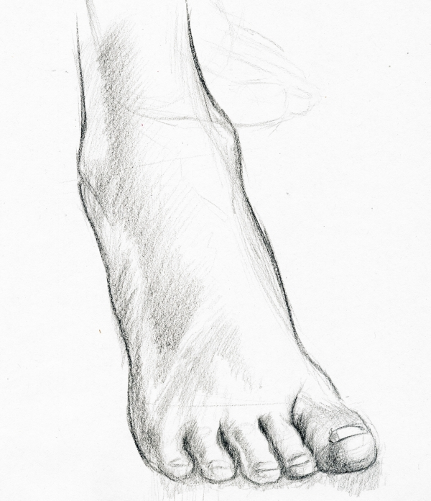
What’s this?

Slide 19
This is a foot!

Slide 20
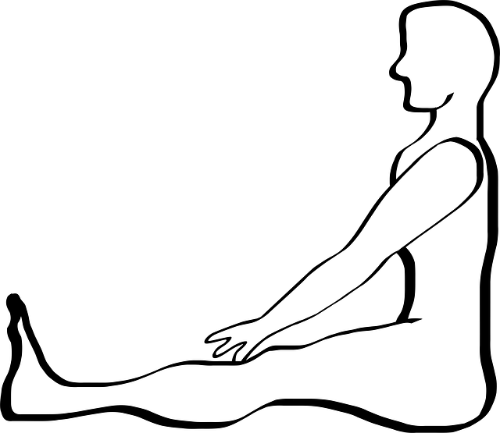








1 – HEAD
2 – SHOULDER
3 – KNEE
4 – TOE
5 – ARM
6 – HAND
7 – LEG
8 – FOOT
MY BODY

