Slide 1

Czech Easter

Slide 2
CZECH EASTER
TOPIC FOR FINAL EXAM

Slide 3
INTRODUCTION
At Easter, people celebrate the arrival of spring commemorating old pagan rituals
It has also deep Christian meaning as the death of Christ is remembered
A number of traditions are observed throughout the country
A variety of customs are practised in different regions
Easter in the Czech Republic is a fun time for men mostly
It is less about Crucifixion and Resurrection and more about celebrating the upcoming spring

Slide 4
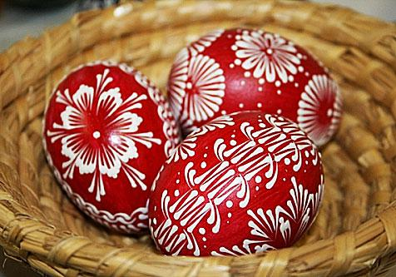
SYMBOLS OF CZECH EASTER
Obr. 1
KRASLICE:HAND-PAINTED EGGS
Colorful hand-painted or otherwise decorated eggs
Either hard-boiled or the yolk is blown and egg shells are used
Various techniques of decorating-dying, batika, scratching, waxing

Slide 5
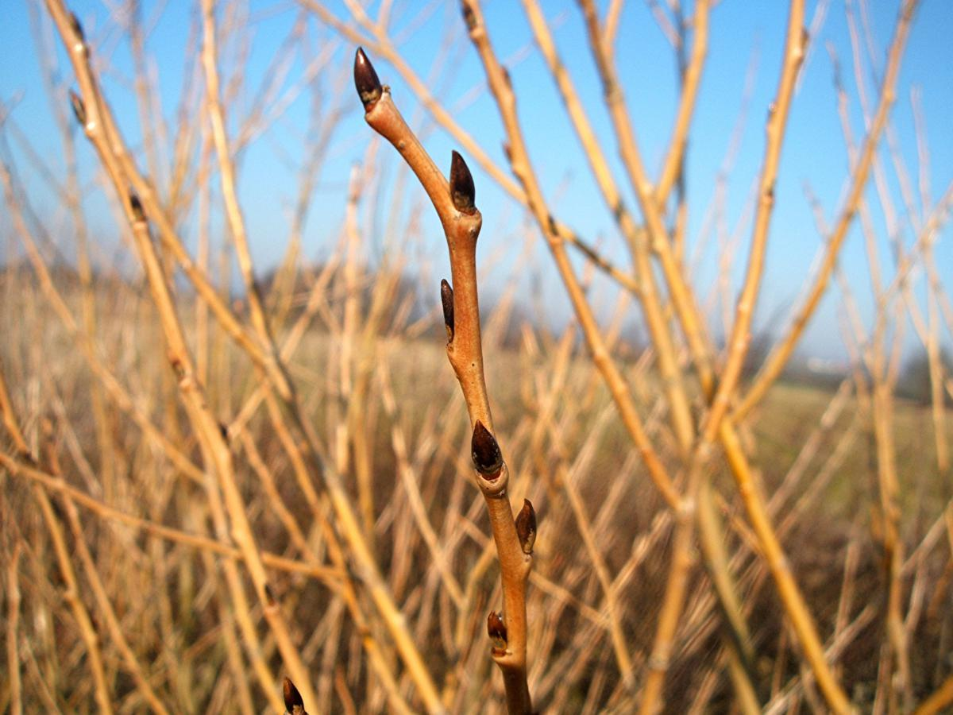
SYMBOLS OF CZECH EASTER
Obr. 2
WILLOW TWIGS
Young live willow twigs are believed to bring health and youth to women who are whipped with them.

Slide 6
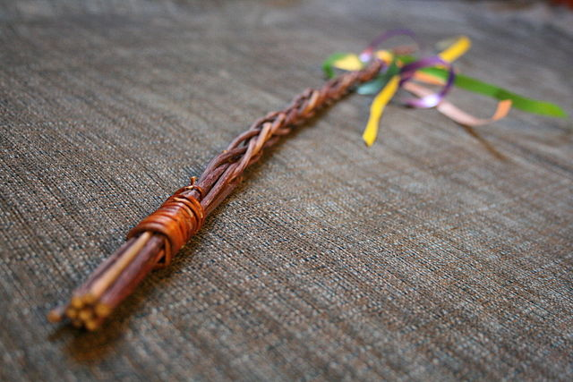
SYMBOLS OF CZECH EASTER
Obr. 3
EASTER POMLÁZKA
Easter pomlázka is a braided whip made from willow twigs.
It is usually made from 8 to 12 branches
Decorated with ribbons

Slide 7
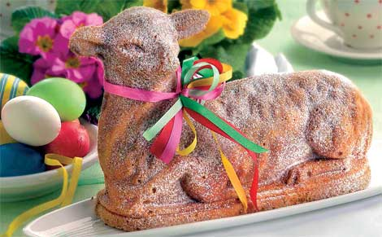
SYMBOLS OF CZECH EASTER
Obr.4
BERÁNEK
It is a sweet yeast bread dessert in the form of a lamb

Slide 8
EASTER CUSTOMS
EASTER SPANKING 1
In cities and villages alike, the tradition of whipping and spanking girls has been practised.
Men are allowed to spank or whip the girls on the legs or bottoms with pomlázka This is to be done symbolically and no harm is intended.
Spanking is thought to chase away illness and keep the women young and beautiful
During the spanking, a carol would be sung or recited by the men
Sometimes a wooden rattle is carried by some men

Slide 9
EASTER CUSTOMS
EASTER SPANKING 2
In reward, men get colored eggs or a small sum of money as a sign of thanks.
These days adults are more likely to be treated with a shot of plum brandy or vodka
Little boys get sweets, chocolate or candy

Slide 10
EASTER CUSTOMS
POURING WATER
Whipping can be accompanied by boys pouring down water(usually from a bucket)on girls
In some regions women can even get their revenge as they are allowed to pour down water on men

Slide 11
EASTER TIME
In general, Czechs like to eat and drink too much at Easter
Easter Monday is a day off
Easter markets run for two or more weeks before and after Easter
Not many men can make their own pomlázka as it is available at nearly all shops
Men sometimes forget to be gentle while they spank the girls
Easter in the Czech Republic is a fun time for men mostly
It is less about Crucifixion and Resurrection and more about celebrating the upcoming spring

Slide 12
Použité zdroje
Použité obrázky
Obr.1: CALLOW, Graham. www.naturespot.org. co.uk [online]. [cit. 25.1.2013]. Dostupný na WWW: :http://www.naturespot.org.uk/species/white-welsh-willow
Obr.2: AUTOR NEUVEDEN, www.zamek-slavkov.cz [online]. [cit. 25.1.2013]. Dostupný na WWW: http://www.zamek-slavkov.cz/cz/kalendar-udalosti/?date=2012-04-1
Obr.3: AUTOR NEUVEDEN. www.ireceptar.cz [online]. [cit. 25.1.2013]. Dostupný na WWW: http://www.ireceptar.cz/vareni-a-recepty/dorty-kolace-cukrovi/sladke-velikonocni-peceni-kuratka-siml-beranci-a-jine-recepty/
Obr.4: AUTOR NEUVEDEN. commons.wikimedia.org[online]. [cit. 25.1.2013]. Dostupný na WWW: http://upload.wikimedia.org/wikipedia/commons/thumb/7/7b/Velikono%C4%8Dn%C3%AD_poml%C3%A1zka1.jpg/640px-Velikono%C4%8Dn%C3%AD_poml%C3%A1zka1.jpg
Pokud není uvedeno jinak, použitý materiál je z vlastních zdrojů autora

