Slide 1

MY HOUSE
Název školy: Základní škola a mateřská škola Bělá
Autor: Mgr. Ivana Pavlíčková
Název: VY_32_INOVACE_05_My house
Období: leden 2013 – červen 2013
Vzdělávací oblast: Jazyk a jazyková komunikace
Téma hodiny: My house
Ročník: 3.
Číslo a název klíčové aktivity: III/2 Inovace a zkvalitnění výuky prostřednictvím ICT
Číslo projektu: CZ.1.07/1.4.00/21.1334

Slide 2
Answer and add word.
Where are you from?
I´m from .................. .
Where do you live?
I live in .................... .
a house
a tent
a flat
a cottage

Slide 3
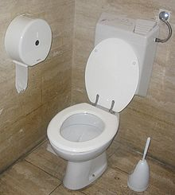
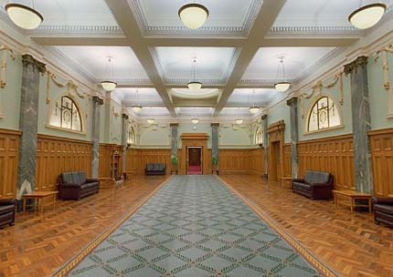
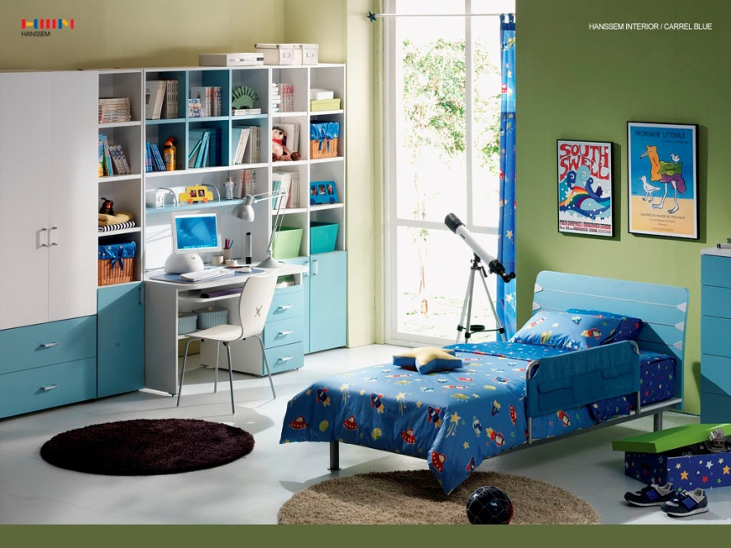
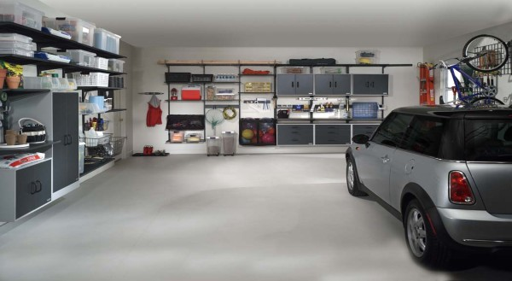
toilet
hall
children´s room
garage

Slide 4
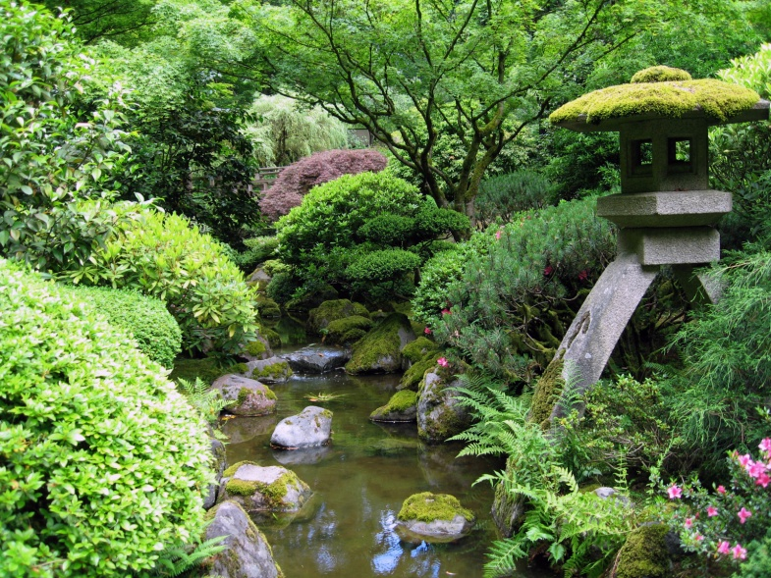
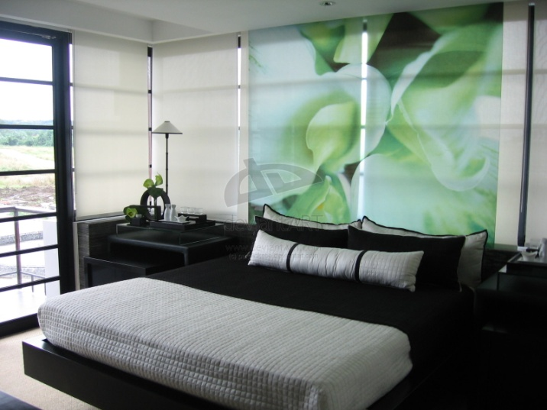
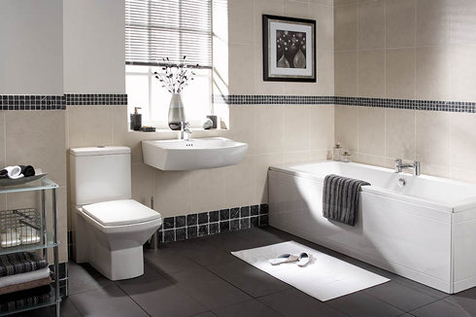
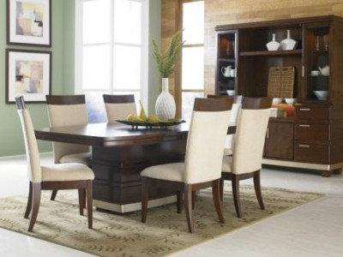
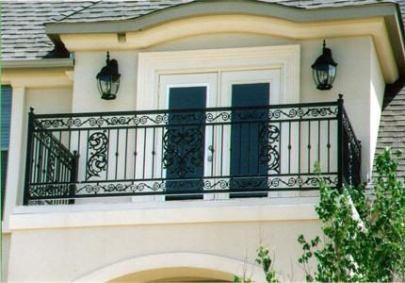
bedroom
garden
bathroom
balcony
dining room

Slide 5
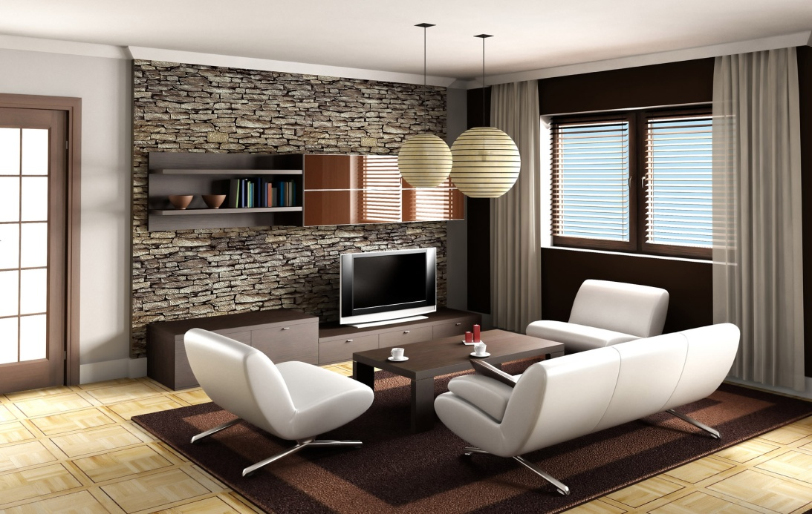
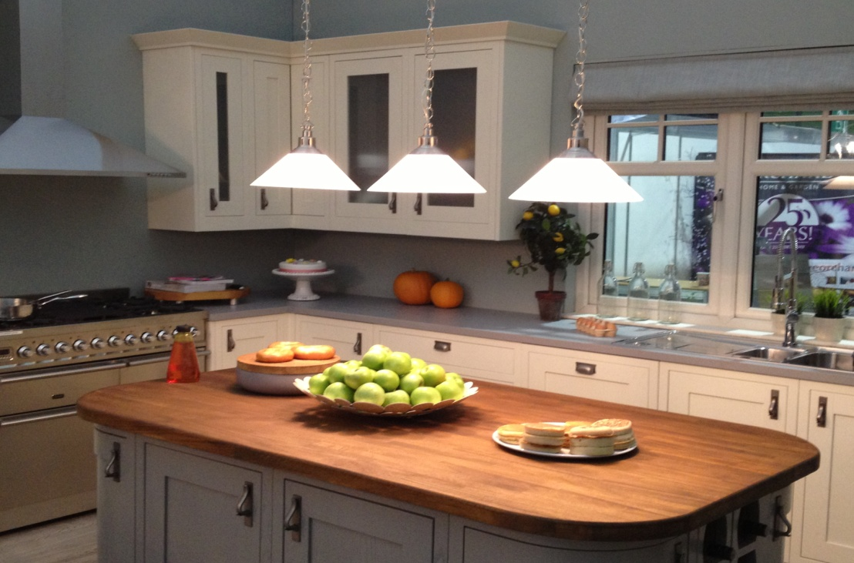
living room
kitchen

Slide 6


hall
garage
bathroom
kitchen
bedroom
dining room

Slide 7

What is it?
bedroom
children´s room
garage
bathroom

Slide 8

What is it?
balcony
garden
living room
dining room

Slide 9
What is it?
toilet
balcony
bedroom
dining room

Slide 10
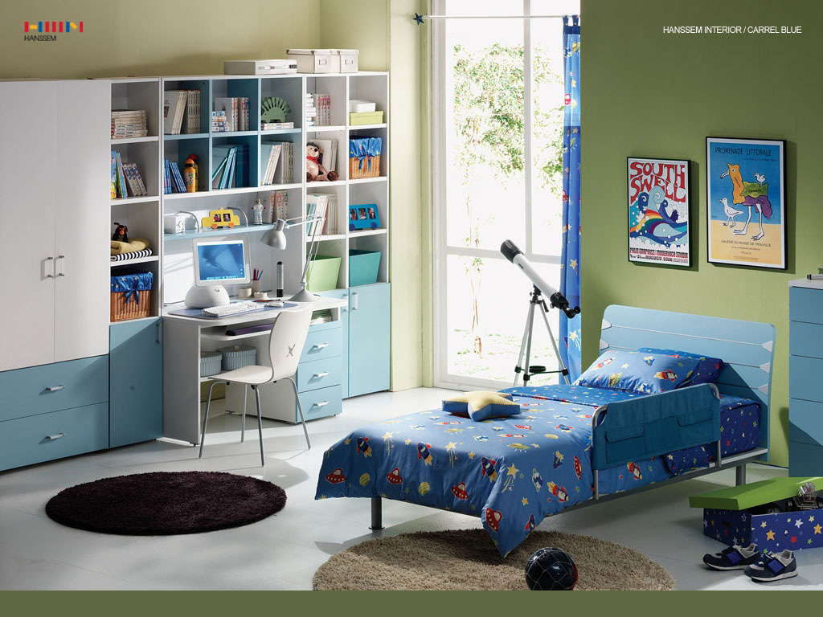
What is it?
bathroom
children´s room
hall
dining room

Slide 11
What is it?
garden
garage
bathroom
balcony

Slide 12
Find 8 words.
A | S | B | G | J | N | V | M | V | Y
G | B | A | T | H | R | O | O | M | J
G | A | L | B | N | V | C | X | H | K
A | X | C | G | J | G | D | J | D | N
R | S | O | J | G | A | R | D | E | N
A | N | N | M | J | L | C | V | Z | H
G | A | Y | V | G | J | R | H | R | A
E | T | K | I | T | C | H | E | N | L
J | T | O | I | L | E | T | S | F | L
L | I | V | I | N | G | R | O | O | M

Slide 13
Solution.
A | S | B | G | J | N | V | M | V | Y
G | B | A | T | H | R | O | O | M | J
G | A | L | B | N | V | C | X | H | K
A | X | C | G | J | G | D | J | D | N
R | S | O | J | G | A | R | D | E | N
A | N | N | M | J | L | C | V | Z | H
G | A | Y | V | G | J | R | H | R | A
E | T | K | I | T | C | H | E | N | L
J | T | O | I | L | E | T | S | F | L
L | I | V | I | N | G | R | O | O | M

Slide 14


Slide 15
Resources
http://www.parliament.nz/VirtualTour/11b.aspx
http://en.wikipedia.org/wiki/Toilet
http://getsimplifized.com/7-steps-to-organize-your-garage
http://www.home-designing.com/2010/07/16-green-color-bedrooms
http://commons.wikimedia.org/wiki/File:Portland_Japanese_garden_creek.jpg
http://www.distinctivedesignin.com/
http://shoaibnzm-home-design.blogspot.cz/2012/07/modern-homes-iron-grill-balcony-designs.html
http://hidc.com.au/facts/furnish-your-dining-room/
http://themaisonette.net/home-interior-children-s-room-design-project
http://www.sodahead.com/fun/well-done-andy-murray/question-3164461/

